Slide 1

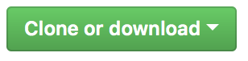

Welcome!
Please download the course material:
Do you have a github account? Give us a star! :)
and store it in a single, accessible folder on your computer. Don’t forget to unzip!
tinyurl.com/introRData > >

Slide 2
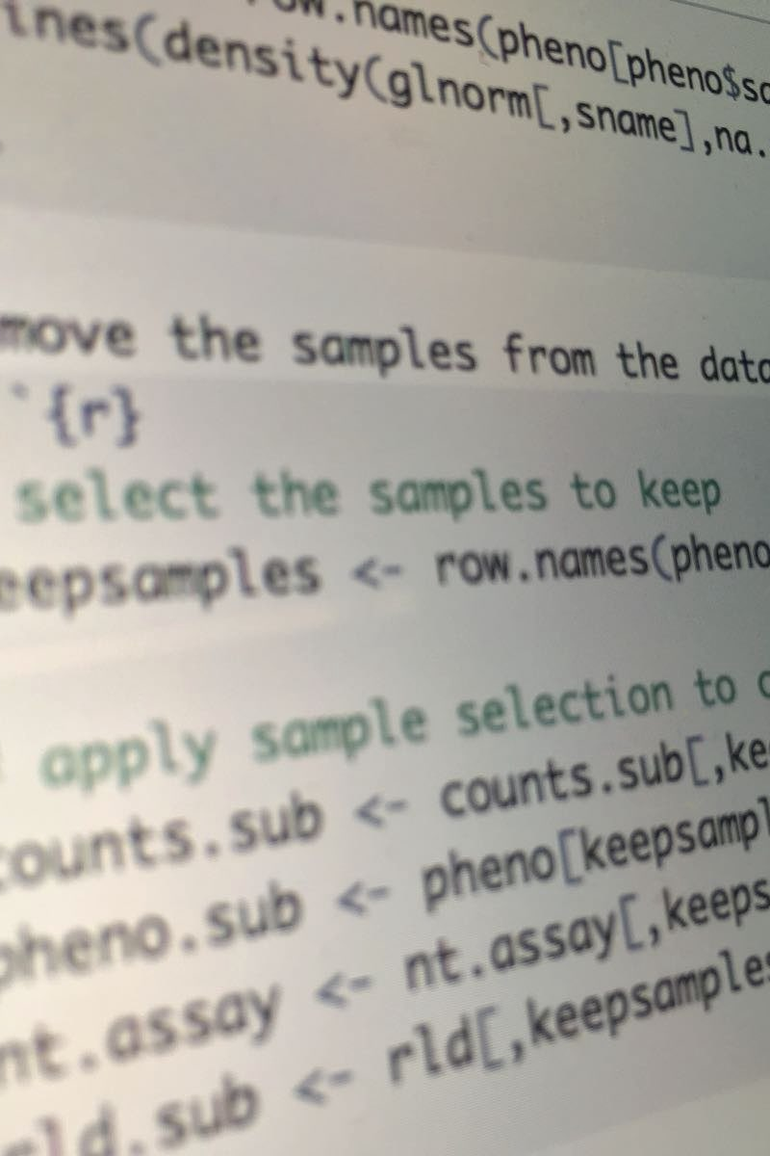
Introduction to R & data
Part I: Basics of R
Lunch (~12:15)
Part II: Modern R with tidyverse
Final remarks (~17:00)

Slide 3
Quick intro: this is us! And who are you?
Jacques Flores
data specialist @ RDM support
j.p.flores@uu.nl
Barbara Vreede
subject specialist Science @ UU Library
b.m.i.vreede@uu.nl

Slide 4
Introduction to R & data
Part 1: Basics of R

Slide 5
What is R?
Widely used programming language for data analysis
Based on statistical programming language S (1976)
Developed by Ross Ihaka & Robert Gentleman (1995)
Very active community, with many (often subject-specific) packages

Slide 6
We will work in RStudio
Integrated Development Environment for R
Founded by JJ Allaire, available since 2010
Bloody useful! Let’s take a look: please open RStudio!

Slide 7
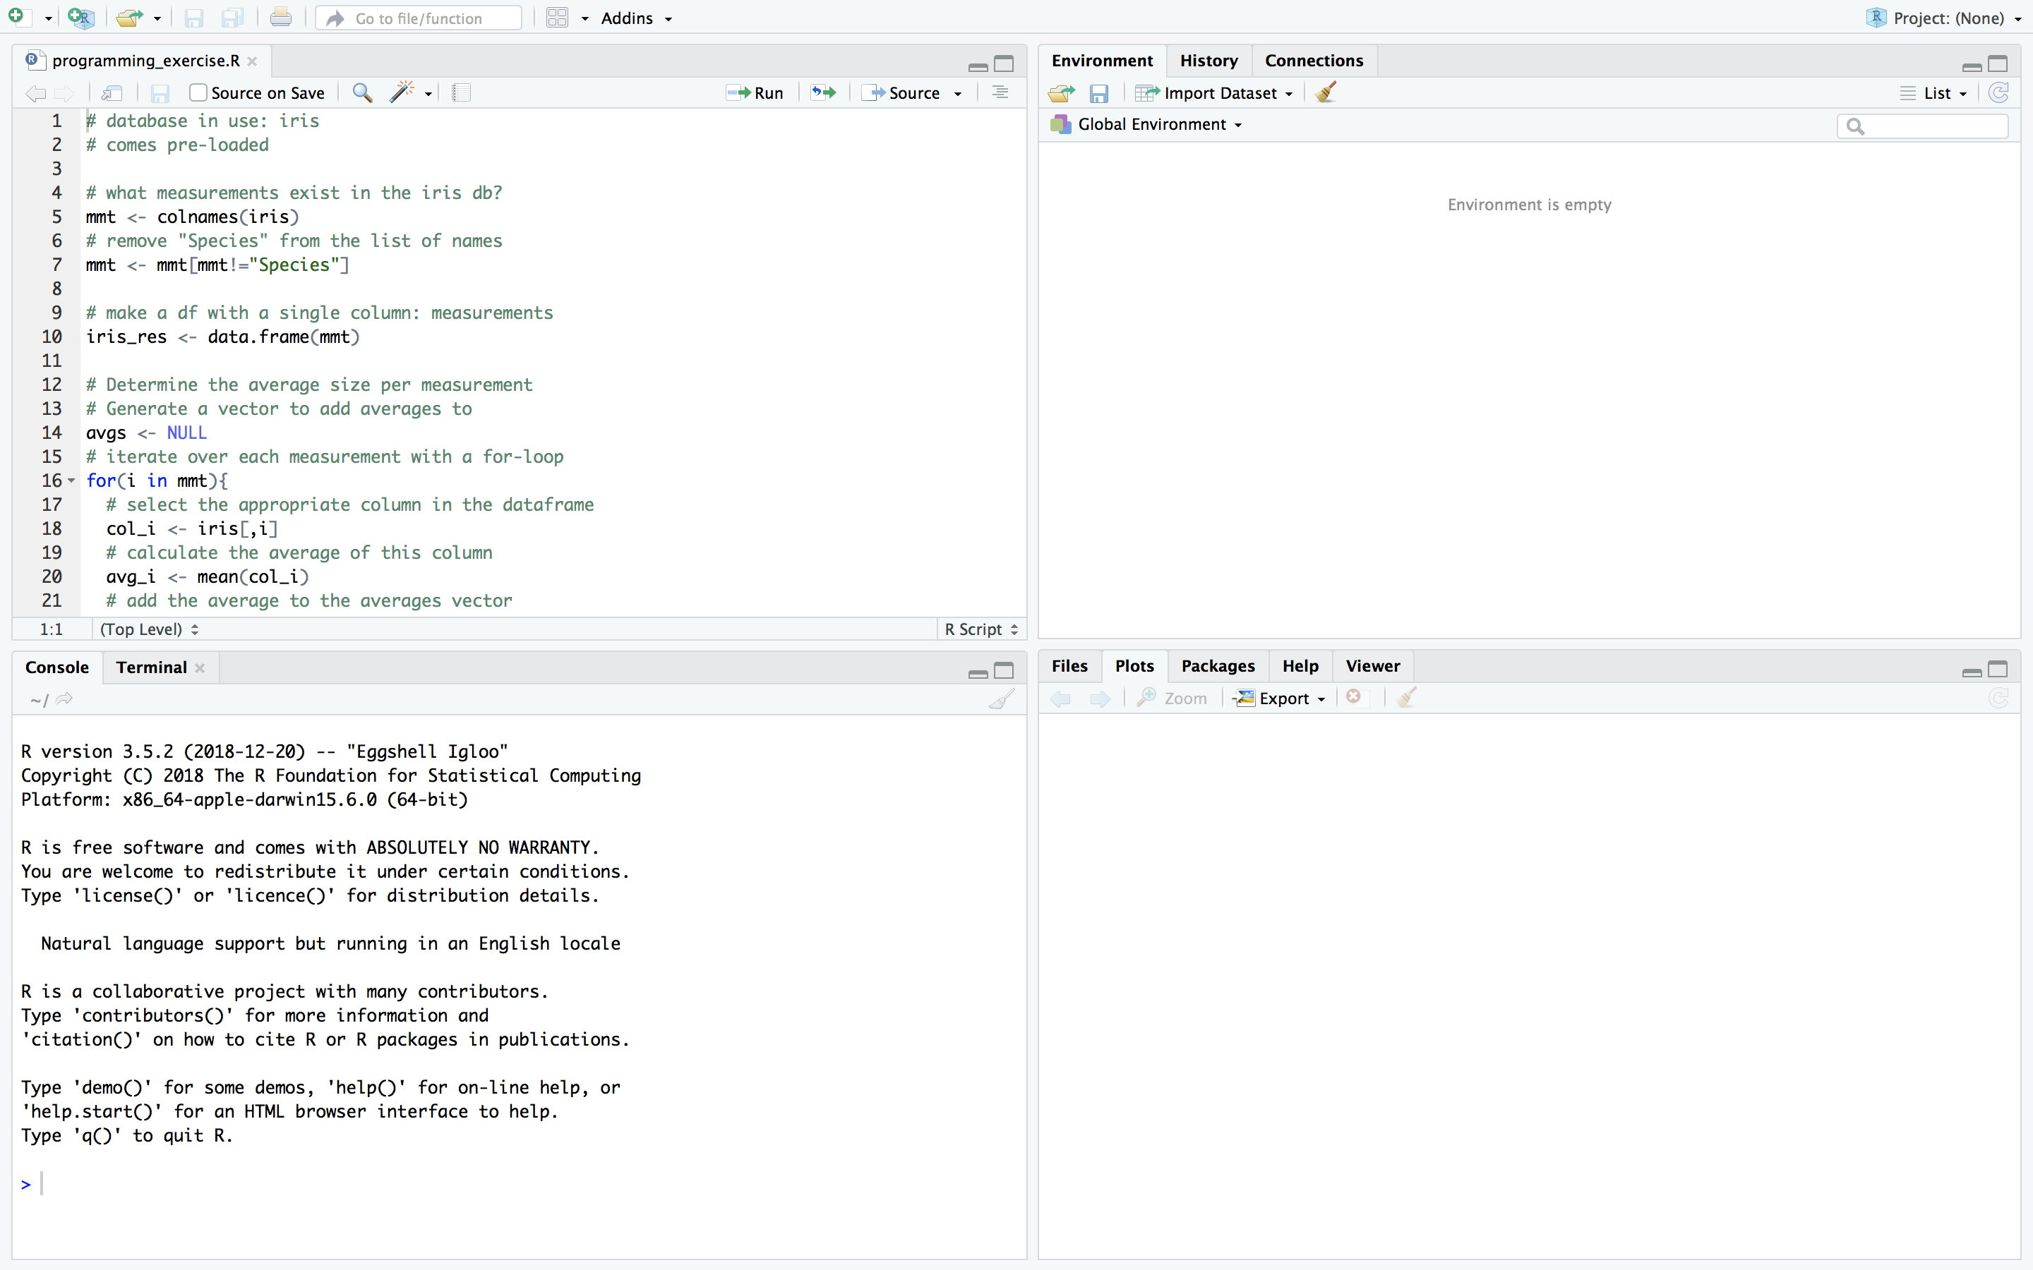
The Rstudio interface
script
markdown
data preview
environment
history
console
files
plots
packages
help

Slide 8
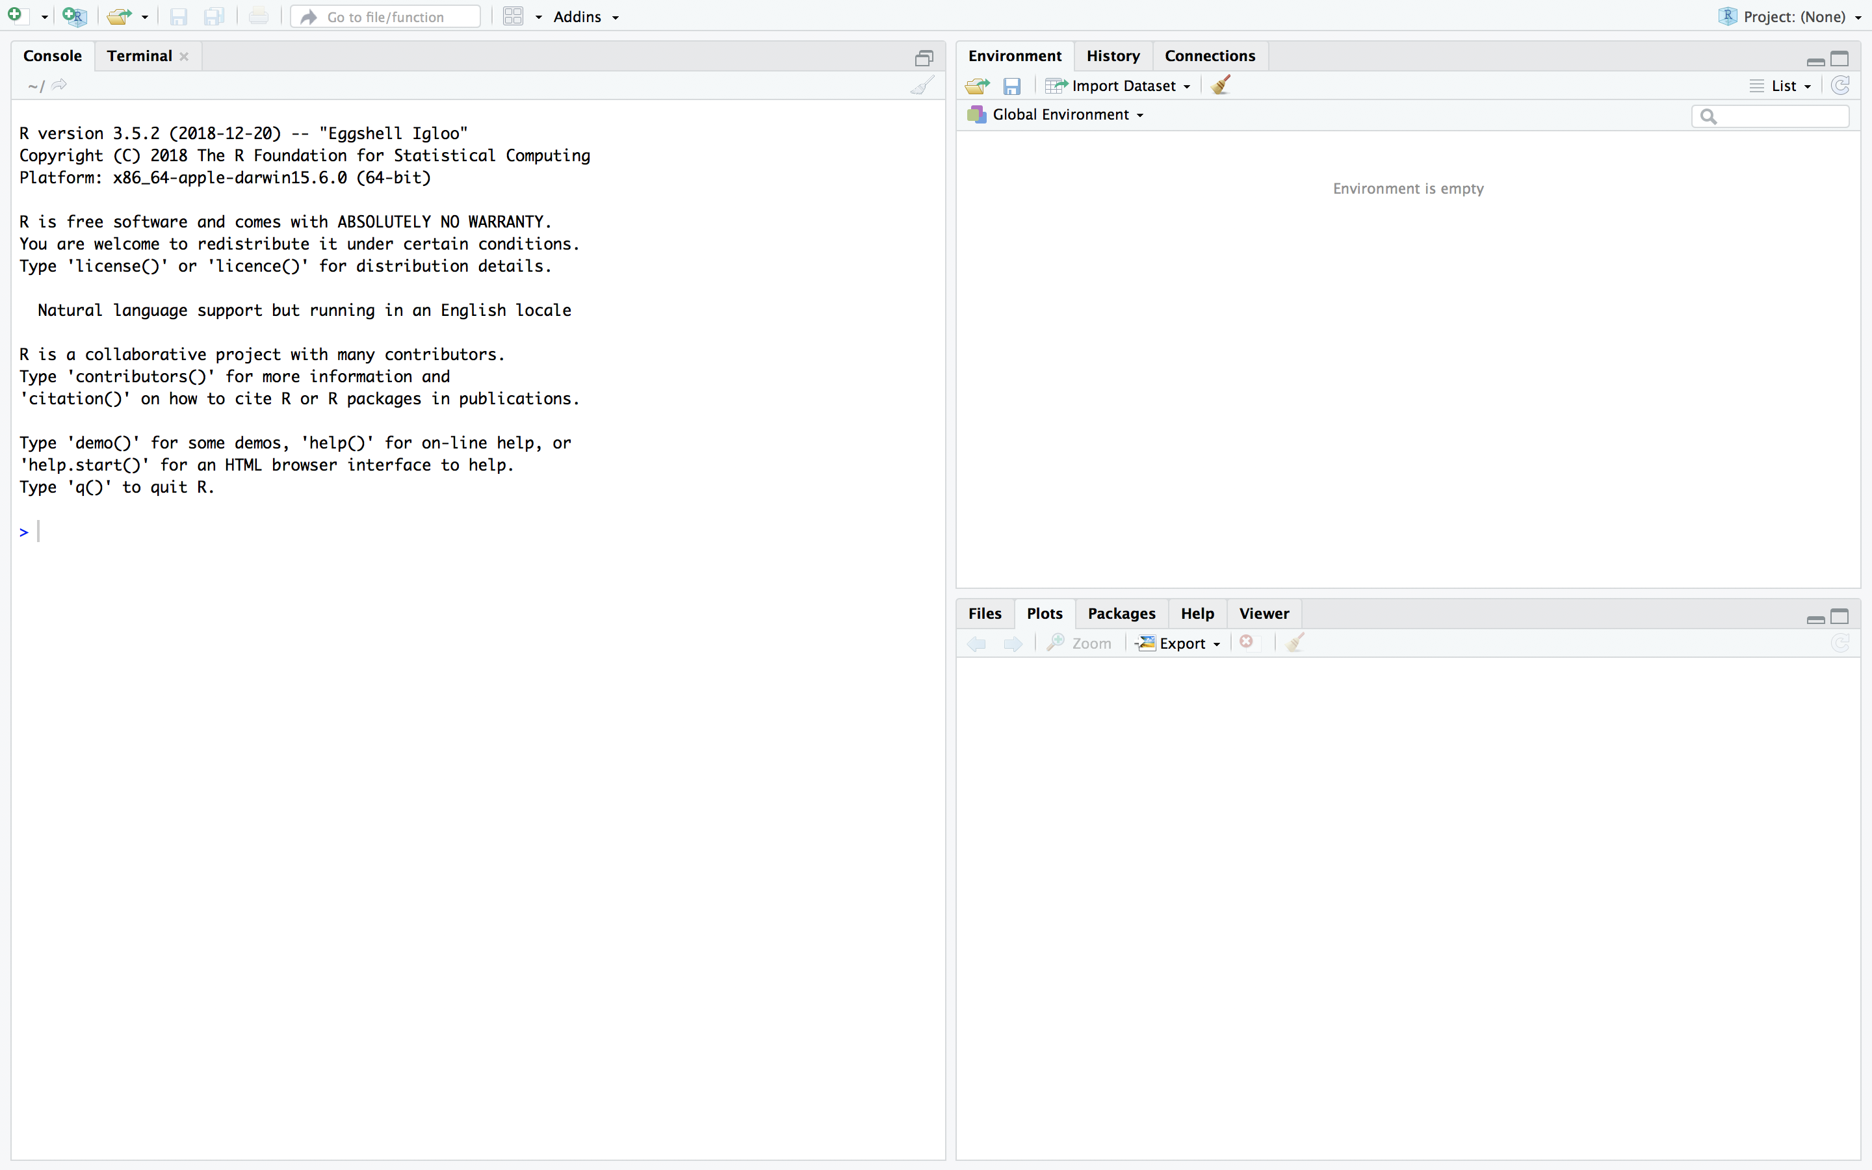
The Rstudio interface
console
environment
history
files
plots
packages
help

Slide 9
Have you downloaded the course material?
Please store it in a single, accessible folder on your computer. Don’t forget to unzip!
tinyurl.com/introRData > >

Slide 10
R syntax & the RStudio console

Slide 11
Variable assignment
> x <- 6

Slide 12
Variable assignment
> x <- 6
> x <- "hi!"
> 6 -> x
> x = 6
> 6 = x
Error in 6 = x : invalid (do_set) left-hand side to assignment

Slide 13
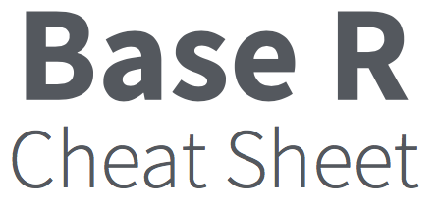
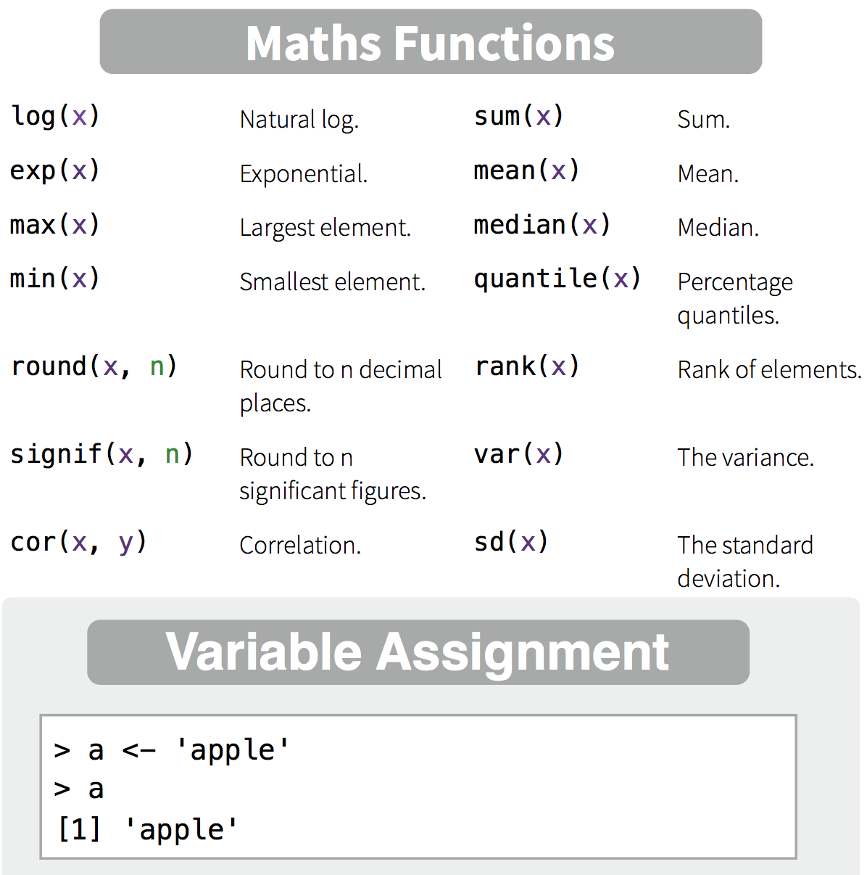
Variable assignment
> x * 3
[1] 18
> y <- x + 2
> log2(y)
[1] 3
Notes:
We can assign values to variables, both numeric and character
We can perform mathematical operations
More complex mathematical operations can be performed using functions.
See your cheatsheet!
You will see that most of these are not operations you can perform on a single number (mean, sum, max, etc). For that, we need another data type.

Slide 14
A quick note on notes
The console is for execution, not for storage
Everything we do is on the slides!
BUT: you can store, if you want, by copy-pasting to a text document
Do you want to write notes in between?
> # write your notes in the console like this
> # using a #hash sign.
> # pressing enter will do nothing.
> # go ahead and try!

Slide 15


Creating vectors
> 1:5
[1] 1 2 3 4 5
> seq(5)
[1] 1 2 3 4 5
> seq(2,4,by=0.5)
[1] 2.0 2.5 3.0 3.5 4.0
> rep(4,6)
[1] 4 4 4 4 4 4
> c(1,61,101)
[1] 1 61 101
> c(2:4,rep(8,3))
[1] 2 3 4 8 8 8
an integer
vs.
a float, or ‘floating point’

Slide 16
Vector functions
> p <- 1:5
> mean(p)
[1] 3
> p * 2
[1] 2 4 6 8 10
> q <- 5:1
> p * q
[1] 5 8 9 8 5
> table(p*q)
5 8 9
2 2 1
p * 2
p | 2
1 | 2 | 2
2 | 2 | 4
3 | 2 | 6
4 | 2 | 8
5 | 2 | 10
p * q
p | q
1 | 5 | 5
2 | 4 | 8
3 | 3 | 9
4 | 2 | 8
5 | 1 | 5

Slide 17
Exercise
1. Write a line of code that produces the following vector:
(Note: there are multiple possible answers!)
[1] 4 4 4 10 15 20 10 7 4
2. Divide the vector by 3. Round up to 1 decimal.
(Hint: check the cheat sheet element ‘Maths Functions’.)

Slide 18
Exercise
1. Write a line of code that produces the following vector:
(Note: there are multiple possible answers!)
> c(rep(4,3),seq(10,20,by=5),seq(10,4,by=-3))
[1] 4 4 4 10 15 20 10 7 4
2. Divide the vector by 3. Round up to 1 decimal.
(Hint: check the cheat sheet element ‘Maths Functions’.)
> v <- c(rep(4,3),seq(10,20,by=5),seq(10,4,by=-3))
> round(v/3,1)
[1] 1.3 1.3 1.3 3.3 5.0 6.7 3.3 2.3 1.3

Slide 19

Another data type: logical
> T
[1] TRUE
> FALSE
[1] FALSE
> 1==1
[1] TRUE
> 3>=5
[1] FALSE
> 2!=4
[1] TRUE
== is equal to
!= is not
>= larger than or equal to
< smaller than

Slide 20



Vectors and factors
> vc <- c("a","b","a","c")
> vc
[1] "a" "b" "a" "c"
> fc <- as.factor(vc)
> fc
[1] a b a c
Levels: a b c
> as.numeric(fc)
[1] 1 2 1 3
Note that vectors may consist of characters!
A factor is defined by its levels. Turning a factor into numeric specifies the order of the levels, but loses their content.

Slide 21
Exercise
1. Generate a vector that contains numeric, logical, and character elements.
2. Turn it into a factor.
3. See what happens to the content when you convert this factor into numeric, logical, and character vectors.
(Hint: check the cheat sheet element ‘Types’ for the functions.)

Slide 22
Exercise
1. Generate a vector that contains numeric, logical, and character elements.
> vt <- c(T,T,2,4,"apple","orange")
2. Turn it into a factor.
> ft <- as.factor(vt)
3. See what happens to the content when you convert this factor into numeric, logical, and character vectors.
(Hint: check the cheat sheet element ‘Types’ for the functions.)
> as.numeric(ft)
[1] 5 5 1 2 3 4
> as.logical(ft)
[1] TRUE TRUE NA NA NA NA
> as.character(ft)
[1] "TRUE" "TRUE" "2" "4" "apple" "orange"

Slide 23
But what if there is no data? Introducing: NA
> ft <- c(T,T,2,4,"apple","orange")
> ft <- as.logical(ft)
> ft
[1] TRUE TRUE NA NA NA NA
> factor(ft)
[1] TRUE TRUE <NA> <NA> <NA> <NA>
Levels: TRUE
NA = Not Available
Name | Age | Pet
Ann | 33 | Cat
Bob | 25 | None
Chloe | 21 | Iguana
Dan | 45 | NA
In other words:
We know that Bob has no pets.
We do not know if Dan has pets.

Slide 24
Exercise: predict the answer
> NA == NA
Predict the results. Does the (real) answer make sense to you?

Slide 25
Exercise: predict the answer
> NA == NA
[1] NA
Predict the results. Does the (real) answer make sense to you?
> is.na(NA)
[1] TRUE

Slide 26

NA != NULL
NA
NULL
“None” or 0
Information is Not Available
Information does not exist
Data entry specifying content of 0
Notes:
It's like determining whether there is coffee or tea in cup. None, there is nothing in the cup. NA we don't know what's in there. NULL, there isn't even a cup (we can't put something in there at all).

Slide 27
Exercise: predict the answer
> is.na(NA)
[1] TRUE
> is.null(NULL)
[1] TRUE
Predict the results. Does the (real) answer make sense to you?
> is.null(NA)
> is.na(NULL)

Slide 28
Exercise: predict the answer
> is.na(NA)
[1] TRUE
> is.null(NULL)
[1] TRUE
Predict the results. Does the (real) answer make sense to you?
> is.null(NA)
[1] FALSE
> is.na(NULL)

Slide 29
Exercise: predict the answer
> is.na(NA)
[1] TRUE
> is.null(NULL)
[1] TRUE
Predict the results. Does the (real) answer make sense to you?
> is.null(NA)
[1] FALSE
> is.na(NULL)
[1] logical(0)

Slide 30
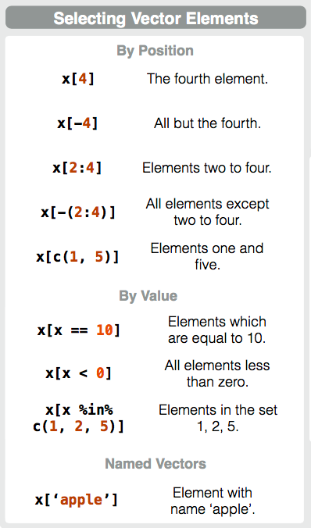
Selecting vector elements by position
> m <- 8:4
> m
[1] 8 7 6 5 4
> m[2]
[1] 7
> m[1:3]
[1] 8 7 6
> m[-(2:4)]
[1] 8 4

Slide 31
Selecting vector elements by value
m | m>5 | result
8 | TRUE | 8
7 | TRUE | 7
6 | TRUE | 6
5 | FALSE
4 | FALSE
> m <- 8:4
> m
[1] 8 7 6 5 4
> m[m>5]
[1] 8 7 6
> m>5
[1] TRUE TRUE TRUE FALSE FALSE
> m[m %in% 5:10]
[1] 8 7 6 5
> m[NA]
[1] NA NA NA NA NA

Slide 32
Which bracket does what?
[ ]
( )
{ }
Indexing vectors, lists, dataframes…
Passing arguments to functions
Defining content of loops, functions, etc.

Slide 33
Vectors, lists, and data frames
> v1 <- 4:6
> v2 <- rep(3,3)
> c(v1,v2)
[1] 4 5 6 3 3 3
> list(v1,v2)
[[1]]
[1] 4 5 6
[[2]]
[1] 3 3 3
> data.frame(v1,v2)
v1 v2
1 4 3
2 5 3
3 6 3
 | how many dimensions? | function
vector | 1 | c()
list | any number | list()
data frame | 2 | data.frame()

Slide 34
Indexing lists
> v1 <- 4:6
> v2 <- rep(3,3)
> mylist <- list(v1,v2)
> mylist[1]
[[1]]
[1] 4 5 6
> mylist[[1]]
[1] 4 5 6
> mylist[[1]][2]
[1] 5
> mylist[1][2]
[[1]]
NULL

Slide 35
Indexing a data frame
> df <- data.frame(name=c("Ann","Bob","Chloe","Dan"),
age=c(33,25,21,45))
> df
name age
1 Ann 33
2 Bob 25
3 Chloe 21
4 Dan 45

Slide 36
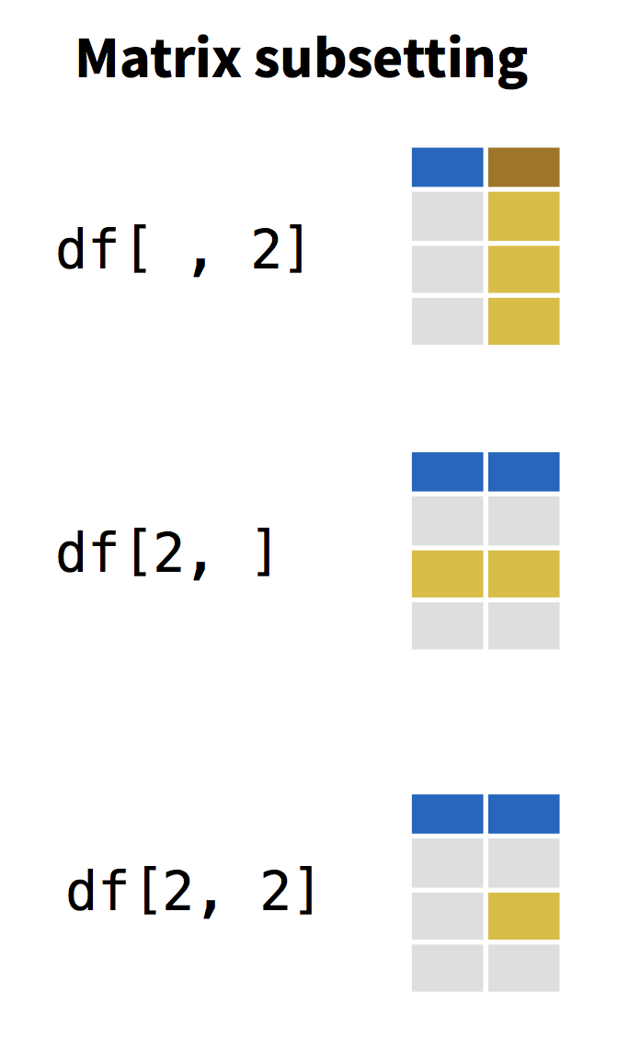


Indexing a data frame
> df$age
[1] 33 25 21 45
> df[,2]
[1] 33 25 21 45
> df[,"age"]
[1] 33 25 21 45
> df[2,]
name age
2 Bob 25
> df[c(1,3),]
name age
1 Ann 33
3 Chloe 21
> df[df$name=="Chloe",2]
[1] 21
row
column

Slide 37
Exercise
Return the names of everyone in your data frame under 30. Make good use of vectors as part of your index!
Hint: this is how you extract a column from a dataframe: df$column_name

Slide 38



Exercise
Return the names of everyone in your data frame under 30. Make good use of vectors as part of your index!
Hint: this is how you extract a column from a dataframe: df$column_name
> df[df$age<30,"name"]
OR
> df[df$age<30,1]
OR
> df$name[df$age<30]
[1] Bob Chloe
Levels: Ann Bob Chloe Dan
Question: what is the data type of your result?
indexing the dataframe df
indexing the vector df$name

Slide 39
Let’s breathe and recap!
What data types have you encountered so far?
logical
numeric
integer
character
factor
And what data collections have you encountered?
vector (one dimension)
data frame (two dimensions)
list (++ dimensions)

Slide 40
Functions
What functions have you encountered so far?
> c()
> rep()
> round()
> as.logical()
> is.na()
> table()
...
And do you still know what they mean? And how to use them? No?
> ?table()
> help.search("standard deviation")
(or use the Help window to the right of your console)

Slide 41
Take a break!
"Fresh Cup" by mikecpeck

Slide 42
Ready?
Writing your first script
Programming with loops and functions
Handling and processing a dataset

Slide 43
Console and Scripts
Console | Code execution | -
Script | Code | Extension: .R (example_script.R)
Rmarkdown | Code + Narrative | Extension: .Rmd (example_report.Rmd)

Slide 44
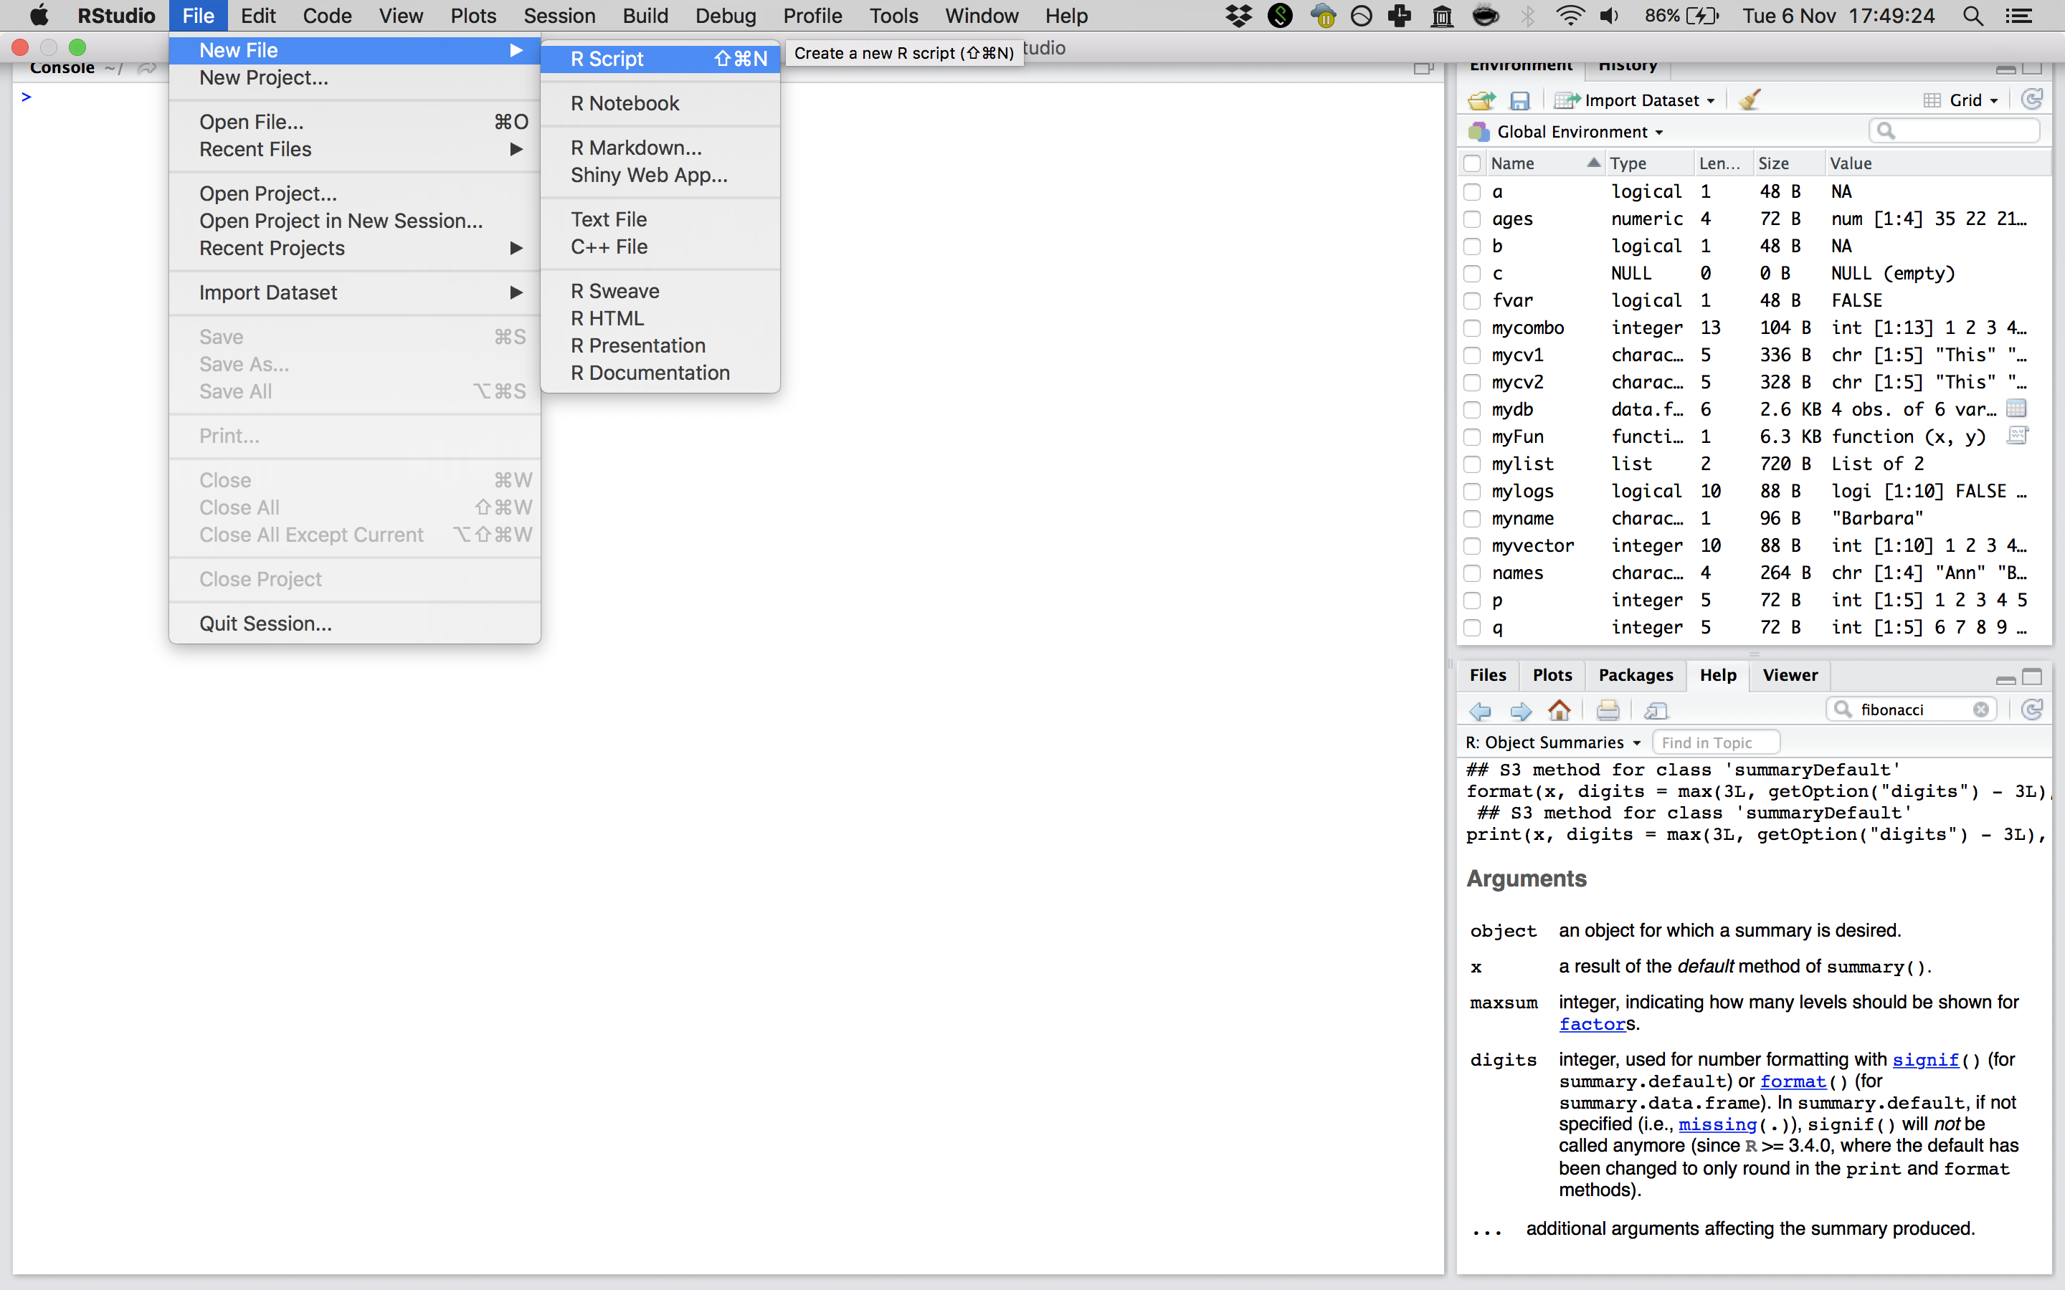
Ready to script?
RStudio > File > New File > R Script
Notes:
SHow how to write a script and execute lines right away!

Slide 45




Console vs script on our slides
> x <- 1
> x
[1] 1
# Assigning the value 1 to x
x <- 1
writing in the console
console output
# indicates comment
computer stops reading (but you should not!)

Slide 46
Introducing a sample dataset
Dataset: ‘iris’
Standard dataset in R, measurements on 3 species of iris flowers
Iris setosa
Iris versicolor
Iris virginica

Slide 47
Introducing a sample dataset
Dataset: ‘iris’
Standard dataset in R, measurements on 3 species of iris flowers
> head(iris)
Sepal.Length Sepal.Width Petal.Length Petal.Width Species
1 5.1 3.5 1.4 0.2 setosa
2 4.9 3.0 1.4 0.2 setosa
3 4.7 3.2 1.3 0.2 setosa
4 4.6 3.1 1.5 0.2 setosa
5 5.0 3.6 1.4 0.2 setosa
6 5.4 3.9 1.7 0.4 setosa
> summary(iris)
Sepal.Length Sepal.Width Petal.Length Petal.Width Species
Min. :4.300 Min. :2.000 Min. :1.000 Min. :0.100 setosa :50
1st Qu.:5.100 1st Qu.:2.800 1st Qu.:1.600 1st Qu.:0.300 versicolor:50
Median :5.800 Median :3.000 Median :4.350 Median :1.300 virginica :50
Mean :5.843 Mean :3.057 Mean :3.758 Mean :1.199
3rd Qu.:6.400 3rd Qu.:3.300 3rd Qu.:5.100 3rd Qu.:1.800
Max. :7.900 Max. :4.400 Max. :6.900 Max. :2.500
Notes:
Recognize factor and numeric data

Slide 48
Programming: for loop
# Iterate over 10 values
for(i in 1:10){
print(i)
}
[1] 1
[1] 2
[1] 3
[1] 4
[1] 5
[1] 6
[1] 7
[1] 8
[1] 9
[1] 10

Slide 49
Calculating averages: preparation
# what measurements exist in the iris db?
measure <- colnames(iris)
> measure
[1] "Sepal.Length" "Sepal.Width" "Petal.Length" "Petal.Width" "Species"
# remove "Species" from the list of names
measure <- measure[measure!="Species"]
# make a df with a single column: measurements
iris_res <- data.frame(measurements=measure)
# initiate a vector for averages
avgs <- NULL
Notes:
Only write the code, not necessary to write the comments (you will receive a script with comments)

Slide 50
Calculating averages in a for loop
# iterate over each measurement with a for-loop
for(m in measure){
}

Slide 51
Calculating averages in a for loop
# iterate over each measurement with a for-loop
for(m in measure){
# select the appropriate column
# calculate the average for this column
# put the average in the averages vector
}

Slide 52
Calculating averages in a for loop
# iterate over each measurement with a for-loop
for(m in measure){
# select the appropriate column
column <- iris[,m]
# calculate the average for this column
# put the average in the averages vector
}

Slide 53
Calculating averages in a for loop
# iterate over each measurement with a for-loop
for(m in measure){
# select the appropriate column
column <- iris[,m]
# calculate the average for this column
avg <- mean(column)
# put the average in the averages vector
}

Slide 54
Calculating averages in a for loop
# iterate over each measurement with a for-loop
for(m in measure){
# select the appropriate column
column <- iris[,m]
# calculate the average for this column
avg <- mean(column)
# put the average in the averages vector
avgs <- c(avgs,avg)
}
> avgs
[1] 5.843333 3.057333 3.758000 1.199333

Slide 55
Calculating averages in a for loop
# add the averages as a column to the data frame
iris_res$average <- avgs
> iris_res
measurement average
1 Sepal.Length 5.843333
2 Sepal.Width 3.057333
3 Petal.Length 3.758000
4 Petal.Width 1.199333

Slide 56
Programming: functions
myFun <- function(x){
return(x)
}
> myFun(1)
[1] 1

Slide 57
Programming: functions
myFun2 <- function(x){
x <- x*20
return(x)
}
> myFun2(1)
[1] 20

Slide 58
Programming: functions
myFun3 <- function(x,y){
z <- x*y
return(z)
}
> myFun3(2,4)
[1] 8

Slide 59
Exercise: combine functions and for loops
Open the script programming_exercise.R
You will see the for-loop (including comments) as we have just written
You will then see the start of a function:
average_df <- function(df){
measure <- colnames(df)
measure <- measure[measure!="Species"]
avgs <- NULL
### ENTER YOUR OWN CODE ###
return(avgs)
}
Exercise: place the for-loop in the function, and edit as necessary, so that the function now generates a list of averages.
TIP: within the function, iris is renamed df!

Slide 60
Exercise: combine functions and for loops
average_df <- function(df){
# determine measurement names and remove species
measure <- colnames(df)
measure <- measure[measure!="Species"]
# initialize the vector
avgs <- NULL
# iterate over each measurement with a for-loop
for(m in measure){
# select the appropriate column
column <- df[,m]
# calculate the average
avg <- mean(column)
# put the average in the averages vector
avgs <- c(avgs,avg)
}
# return the averages as a column
return(avgs)
}
# apply the function: add the averages as a column to the data frame
iris_res$average <- average_df(iris)

Slide 61
Programming: if statement
if(4>5){
print("math has changed!")
} else{
print("all is well.")
}

Slide 62
Programming: if statement
if(4>5){
print("math has changed!")
} else if(5>6){
print("this is not good either!")
} else{
print("all is well.")
}

Slide 63
Exercise: add an if-statement to your function
We want to build on our average_df function so it can do more calculations!
To do this, we add a second argument, and include an if statement.
First, copy-paste your function, and give it a new name. Consider changing some variable names, too (and make sure to change them all!).
stats_df <- function(df){
measure <- colnames(df)
measure <- measure[measure!="Species"]
results <- NULL
for(m in measure){
column <- df[,m]
res <- mean(column)
results <- c(results,res)
}
return(results)
}
Notes:
Leave the comments in your script! The comments are left out on the screen for brevity, but please don’t do that yourself.

Slide 64
Exercise: add an if-statement to your function
Our function can calculate averages. We might want to add standard deviations ( sd()), maximums ( max()), and minimums ( min()).
Which line in the function do we need to expand on, to allow this?
What additional information do we need?
stats_df <- function(df){
measure <- colnames(df)
measure <- measure[measure!="Species"]
results <- NULL
for(m in measure){
column <- df[,m]
res <- mean(column)
results <- c(results,res)
}
return(results)
}

Slide 65
Exercise: add an if-statement to your function
stats_df <- function(df,fnx){
measure <- colnames(df)
measure <- measure[measure!="Species"]
results <- NULL
for(m in measure){
column <- df[,m]
# perform different functions based on the input
if(fnx=="mean"){
res <- mean(column)
} else{
stop("no valid input received")
}
results <- c(results,res)
}
return(res)
}

Slide 66
Exercise: add an if-statement to your function
Add the if-statement below to your function! (Do you understand how it works?)
if(fnx=="mean"){
res <- mean(column)
} else{
stop("no valid input received")
}
Elaborate on the statement using else if, adding alternative functions. Consider standard deviation ( sd()), maximum ( max()), and minimum ( min()).
Finally, call your new function to add columns to your iris_res dataframe!

Slide 67
Exercise: add an if-statement to your function
stats_df <- function(df,fnx){
measure <- colnames(df)
measure <- measure[measure!="Species"]
results <- NULL
for(m in measure){
column <- df[,m]
if(fnx=="mean"){
res <- mean(column)
} else if(fnx=="sd"){
res <- sd(column)
} else{
stop("no valid input received")
}
results <- c(res,res)
}
return(res)
}
iris_res$standarddev <- stats_df(iris,"sd")

Slide 68
Your result: a summary data frame
iris_res$standarddev <- stats_df(iris,"sd")
iris_res$largest <- stats_df(iris,"max")
iris_res$smallest <- stats_df(iris,"min")
> iris_res
measurement average standarddev largest smallest
1 Sepal.Length 5.843333 0.8280661 7.9 4.3
2 Sepal.Width 3.057333 0.4358663 4.4 2.0
3 Petal.Length 3.758000 1.7652982 6.9 1.0
4 Petal.Width 1.199333 0.7622377 2.5 0.1
> summary(iris)
Sepal.Length Sepal.Width Petal.Length Petal.Width Species
Min. :4.300 Min. :2.000 Min. :1.000 Min. :0.100 setosa :50
1st Qu.:5.100 1st Qu.:2.800 1st Qu.:1.600 1st Qu.:0.300 versicolor:50
Median :5.800 Median :3.000 Median :4.350 Median :1.300 virginica :50
Mean :5.843 Mean :3.057 Mean :3.758 Mean :1.199
3rd Qu.:6.400 3rd Qu.:3.300 3rd Qu.:5.100 3rd Qu.:1.800
Max. :7.900 Max. :4.400 Max. :6.900 Max. :2.500

Slide 69
Data science workflow: scripting is crucial
Scripting combines commands to a comprehensive set of instructions.
A script is code that can be saved, reused, shared, published!
In short: a crucial step towards reproducible data analysis.
a single script for a single purpose!

Slide 70
Starting the script: write a header
## Date: 7 November 2018
## Author: Barbara Vreede
## This script was written as part of the R course
## "Introduction to R & Data", at Utrecht University
Notes:
Think about: dependencies, version, purpose…

Slide 71
Load packages and dependencies
## Date: 7 November 2018
## Author: Barbara Vreede
## This script was written as part of the R course
## "Introduction to R & Data", at Utrecht University
# Load required packages
library(dplyr)
library(tidyr)
library(ggplot2)

Slide 72
Custom functions
## Date: 7 November 2018
## Author: Barbara Vreede
## This script was written as part of the R course
## "Introduction to R & Data", at Utrecht University
# Load required packages
library(dplyr)
library(tidyr)
library(ggplot2)
# Functions
myFun <- function(var){
var <- var*2*pi
return(var)
}

Slide 73
Starting your script: header, packages, functions
## Date: 7 November 2018
## Author: Barbara Vreede
## This script was written as part of the R course
## "Introduction to R & Data", at Utrecht University
# Load required packages
library(dplyr)
library(tidyr)
library(ggplot2)
# Functions
myFun <- function(var){
var <- var*2*pi
return(var)
}

Slide 74
To check before lunch: please load tidyverse
> library(tidyverse)
── Attaching packages ─────────────────────── tidyverse 1.2.1 ──
✔ ggplot2 3.1.0 ✔ purrr 0.3.0
✔ tibble 2.0.1 ✔ dplyr 0.7.8
✔ tidyr 0.8.2 ✔ stringr 1.4.0
✔ readr 1.3.1 ✔ forcats 0.3.0
── Conflicts ────────────────────────── tidyverse_conflicts() ──
✖ dplyr::filter() masks stats::filter()
✖ dplyr::lag() masks stats::lag()

Slide 75
Enjoy your lunch!

Slide 76
Introduction to R & data
Part II: Modern R with tidyverse

Slide 77
Outline part II
Introduction to tidyverse, rmarkdown, and tibble.
Load and save data with readr
[break]
Data visualisation with ggplot
[break]
Data transformation with tidyr and dplyr

Slide 78
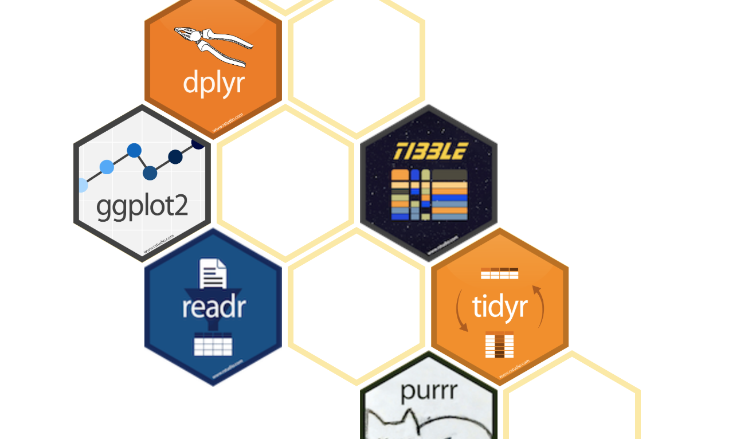
Tidyverse
Modern R for data science
Notes:
Recently developed
Fast adoption by community
Integration with RStudio
Dev by Wickham
- Collection of packages
Everyone can make extensions to the tidyverse
dplyr and ggplot2 are the most well known packages
Easy to switch between base R and tidyverse

Slide 79
"The tidyverse is an opinionated collection of R packages designed for data science. All packages share an underlying design philosophy, grammar, and data structures."
– tidyverse.org (2018)
Notes:
Discuss
Base R is confusing/old, non-intuitive -> tidyverse introduces intuitive functions
Different developers and historical inconsistencies -> tidyverse has a shared grammar
"R is an old language, and some things that were useful 10 or 20 years ago now get in your way. It’s difficult to change base R without breaking existing code, so most innovation occurs in packages."

Slide 80

Data science workflow
Tidy data ensures that further processing can be done efficiently, and reproducibly.
Tidy data is easy to manipulate, model, and visualize.

Slide 81



Tidy data
multiple observations per row
values in column names
Each variable is a column and contains values
Each observation is a row
Each type of observational unit forms a table
Patient | Temp | Med_A | Temp_A | Med_B | Temp_B
122030 | 37.0 | 300 | 37.1 | NA | NA
122021 | 38.2 | 200 | 38.1 | 85 | 36.5
124500 | 38.1 | 300 | 38.0 | NA | NA
126098 | 39.1 | NA | NA | 100 | 36.8

Slide 82




Tidy data
ID no longer unique per row (but can still be used to collect all info on single patient)
Patient | Temp | Treatment | Dose
122030 | 37.0 | None | NA
122030 | 37.1 | A | 300
122021 | 38.2 | None | NA
122021 | 38.1 | A | 200
122021 | 36.5 | B | 85
124500 | 38.1 | None | NA
124500 | 38.0 | A | 300
126098 | 39.1 | None | NA
126098 | 36.8 | B | 100
Time series (order) lost (so make sure this is explicit)

Slide 83

Learn tidyverse
R for Data Science (book); freely available on r4ds.had.co.nz/

Slide 84
Learn tidyverse
R for Data Science (book); freely available on r4ds.had.co.nz/
ggplot2 (book)

Slide 85
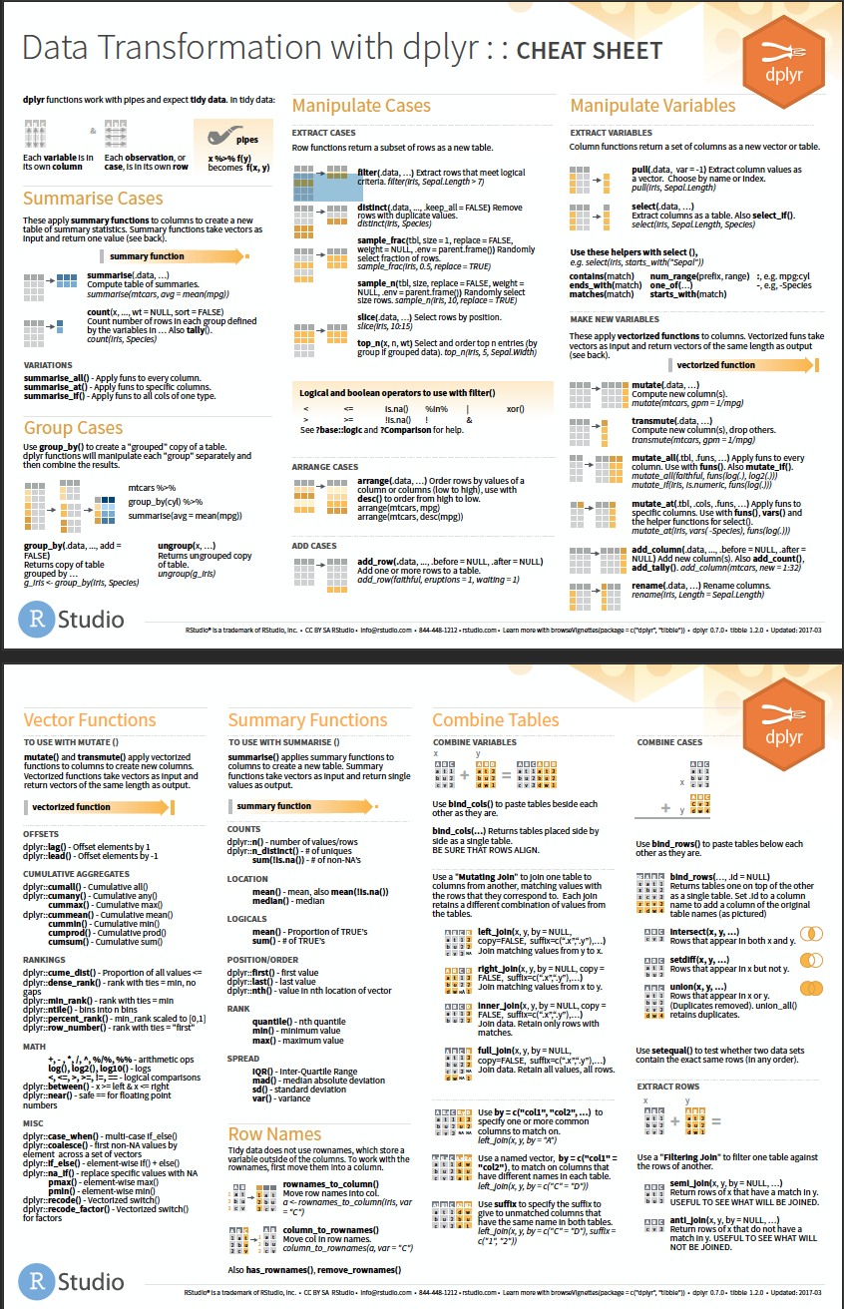
Learn tidyverse
R for Data Science (book); freely available on r4ds.had.co.nz/
ggplot2 (book)
cheatsheets www.rstudio.com/resources/cheatsheets/

Slide 86
Your afternoon roadmap
A short explanation on screen (~15 minutes)
Exercises in a document on your computer (~45 minutes)
2-3 basic exercises
optional exercises, for further practice
reading exercises, for some extra insight into Tidyverse
We will work with a new data set
The exercises are presented in Rmarkdown format. We’ll explain this later!

Slide 87

From code to document
Turn your analyses into high quality documents with Rmarkdown
Combine code with narrative (R with markdown)
Turn your analyses into high quality documents, reports, presentations and dashboards.
… or your note book.

Slide 88
Console, Scripts and Rmarkdown
Console | Code execution | -
Script | Code | Extension: .R (example_script.R)
Rmarkdown | Code + Narrative | Extension: .Rmd (example_report.Rmd)
Notes:
Move and duplicate this slide.
Remove Rmarkdown at this stage. Show it later on

Slide 89
Markdown
# title
Some text about your project
## Section
More text about your project
```{r}
max(iris$Petal.Length)
min(iris$Petal.Length)
```

Slide 90
Rmarkdown: demo

Slide 91
Exercise: open the exercise Rmarkdown
1. RStudio > File > Open Project > introduction-to-R-and-data-github.Rproj
2. From the ‘files’ menu (bottom right), select modernR_exercises.Rmd
3. Update the header information with your name!

Slide 92
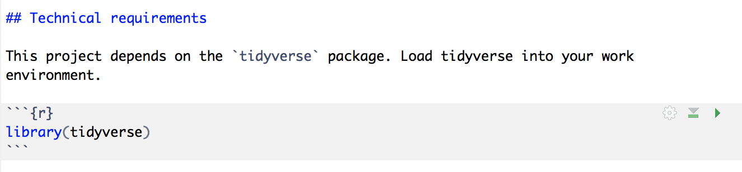

Run the first code chunk!
> library(tidyverse)
── Attaching packages ─────────────────────── tidyverse 1.2.1 ──
✔ ggplot2 3.1.0 ✔ purrr 0.3.0
✔ tibble 2.0.1 ✔ dplyr 0.7.8
✔ tidyr 0.8.2 ✔ stringr 1.4.0
✔ readr 1.3.1 ✔ forcats 0.3.0
── Conflicts ────────────────────────── tidyverse_conflicts() ──
✖ dplyr::filter() masks stats::filter()
✖ dplyr::lag() masks stats::lag()

Slide 93
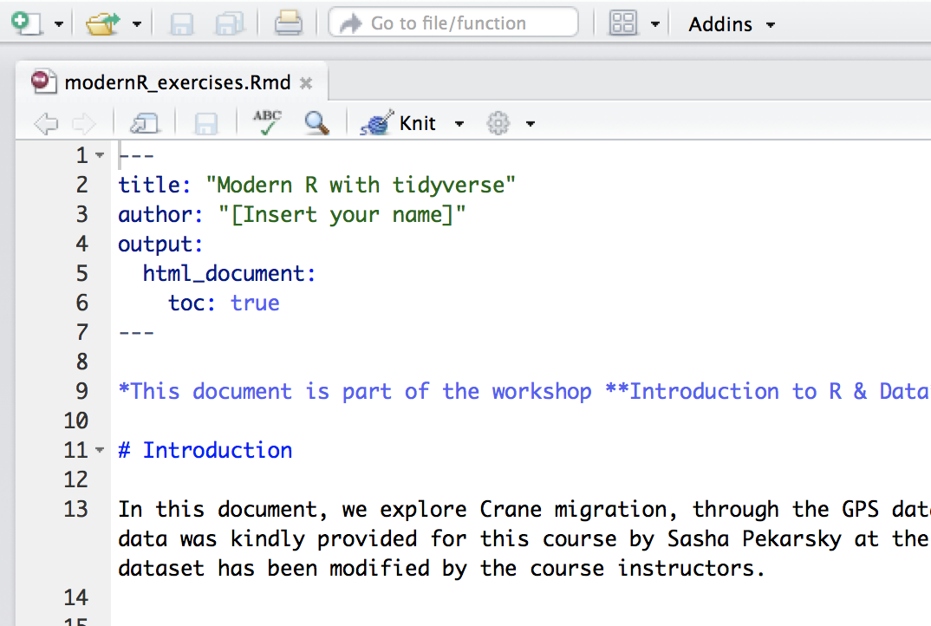

All done? Time to knit!

Slide 94

package: Tibble
"Tibbles are data frames, but they tweak some older behaviours to make life a little easier.”
- Hadley Wickham

Slide 95
Tibbles
> tibble(a = 1:26, b = letters)
# A tibble: 26 x 2
a b
<int> <chr>
1 1 a
2 2 b
3 3 c
4 4 d
5 5 e
6 6 f
7 7 g
8 8 h
9 9 i
10 10 j
# ... with 16 more rows

Slide 96
Tibbles: from data.frame to tibble
> as_tibble(iris)
# A tibble: 150 x 5
Sepal.Length Sepal.Width Petal.Length Petal.Width Species
<dbl> <dbl> <dbl> <dbl> <fct>
1 5.10 3.50 1.40 0.200 setosa
2 4.90 3.00 1.40 0.200 setosa
3 4.70 3.20 1.30 0.200 setosa
4 4.60 3.10 1.50 0.200 setosa
5 5.00 3.60 1.40 0.200 setosa
6 5.40 3.90 1.70 0.400 setosa
7 4.60 3.40 1.40 0.300 setosa
8 5.00 3.40 1.50 0.200 setosa
9 4.40 2.90 1.40 0.200 setosa
10 4.90 3.10 1.50 0.100 setosa
# ... with 140 more rows

Slide 97
Tibbles: from tibble to data.frame
> iris_tibble <- as_tibble(iris)
> as.data.frame(iris_tibble)
Sepal.Length Sepal.Width Petal.Length Petal.Width Species
1 5.1 3.5 1.4 0.2 setosa
2 4.9 3.0 1.4 0.2 setosa
3 4.7 3.2 1.3 0.2 setosa
4 4.6 3.1 1.5 0.2 setosa
5 5.0 3.6 1.4 0.2 setosa
6 5.4 3.9 1.7 0.4 setosa
7 4.6 3.4 1.4 0.3 setosa
8 5.0 3.4 1.5 0.2 setosa
9 4.4 2.9 1.4 0.2 setosa
10 4.9 3.1 1.5 0.1 setosa
11 5.4 3.7 1.5 0.2 setosa
12 4.8 3.4 1.6 0.2 setosa
13 4.8 3.0 1.4 0.1 setosa
14 4.3 3.0 1.1 0.1 setosa
15 5.8 4.0 1.2 0.2 setosa
16 5.7 4.4 1.5 0.4 setosa
17 5.4 3.9 1.3 0.4 setosa
18 5.1 3.5 1.4 0.3 setosa
19 5.7 3.8 1.7 0.3 setosa
20 5.1 3.8 1.5 0.3 setosa
21 5.4 3.4 1.7 0.2 setosa
22 5.1 3.7 1.5 0.4 setosa
23 4.6 3.6 1.0 0.2 setosa
24 5.1 3.3 1.7 0.5 setosa

Slide 98

Load and save data
The basics of readr

Slide 99
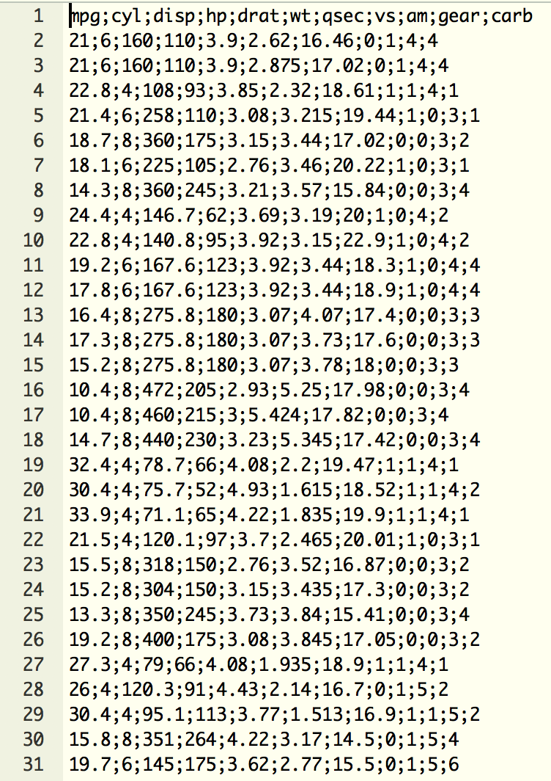
Flat data files
Most common format: Comma-separated values (CSV)
Delimiter-separated values (also stored as CSV)
Common delimiters:
comma ,
semicolon ;
tab \t

Slide 100
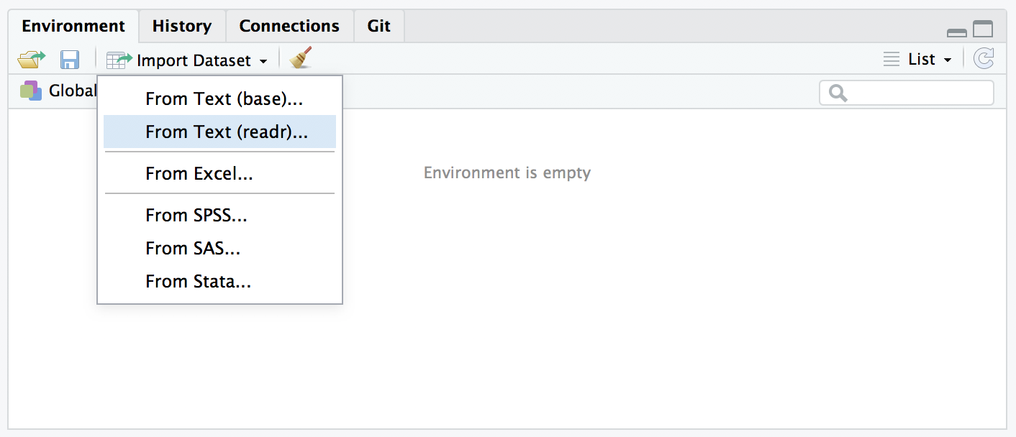

Load data by using buttons

Slide 101
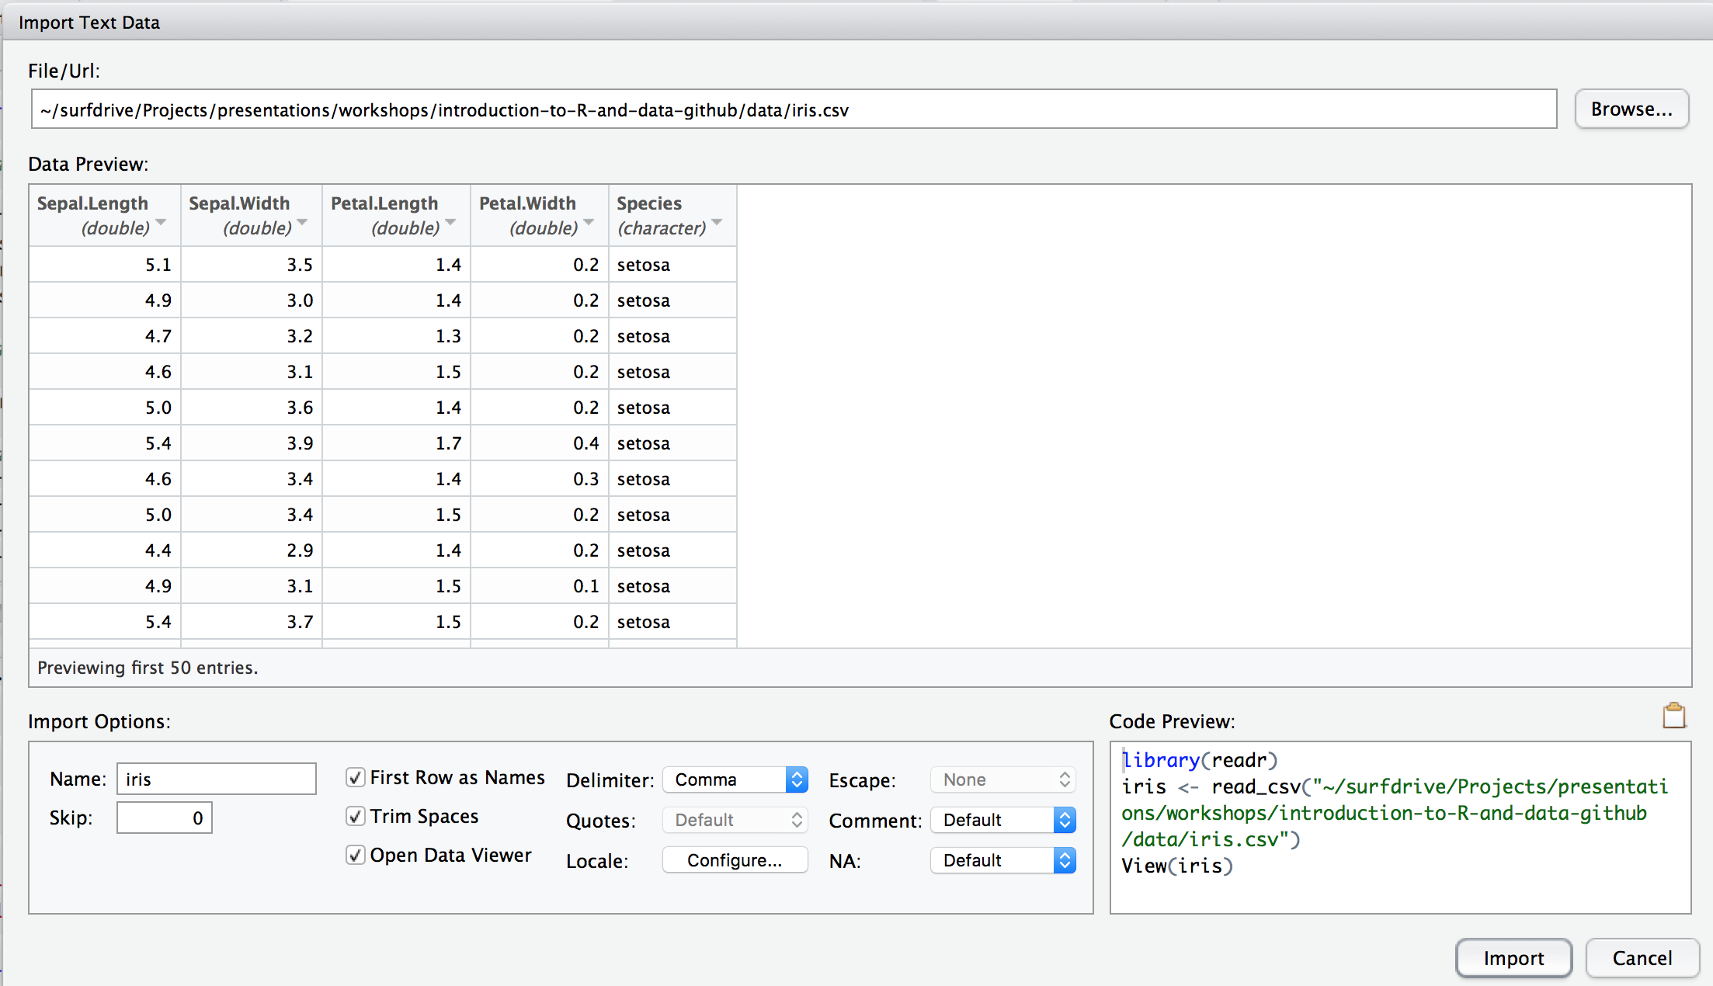


Load data by using buttons

Slide 102

Read flat files
> library(readr)
> data_iris <- read_delim("data/iris.csv", delim=',')

Slide 103
Read flat files
> library(readr)
> data_iris <- read_delim("data/iris.csv", delim=',')
Parsed with column specification:
cols(
Sepal.Length = col_double(),
Sepal.Width = col_double(),
Petal.Length = col_double(),
Petal.Width = col_double(),
Species = col_character()
)

Slide 104
Read flat files
> library(readr)
> data_iris <- read_csv("data/iris.csv")
Parsed with column specification:
cols(
Sepal.Length = col_double(),
Sepal.Width = col_double(),
Petal.Length = col_double(),
Petal.Width = col_double(),
Species = col_character()
)

Slide 105
Exercise dataset
GPS data from 39 tagged individual cranes during fall migration of 2017
Courtesy of Sasha Pekarsky at the Hebrew University of Jerusalem, Israel
In the ‘data’ folder of your course materials.
Notes:
Yes Jonathan, cranes are birds.

Slide 106
Exercises
Please do basic exercises 1-I and 1-II.
Time left? Opt for a reading exercise or optional exercise!

Slide 107

Data visualisation
Create eye candy with ggplot2

Slide 108
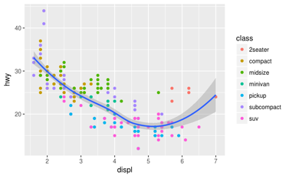
Examples of plots with R (and ggplot2)

Slide 109
Data visualisation with ggplot2
ggplot2 is an extremely popular data visualisation package for R
Simple syntax, easy to learn, nice plots
Developed and maintained by Hadley Wickham
Based on the book: The Grammar of Graphics (Wilkinson, 2005)

Slide 110
The grammar of graphics
Data | The variables in a tibble or data.frame
Aesthetics | x- and y-axis, colour, size, alpha, shape
Geometries | point, line, bar, histogram
Source: https://www.youtube.com/watch?v=uiTc55clwuA

Slide 111
Quick plotting

Slide 112
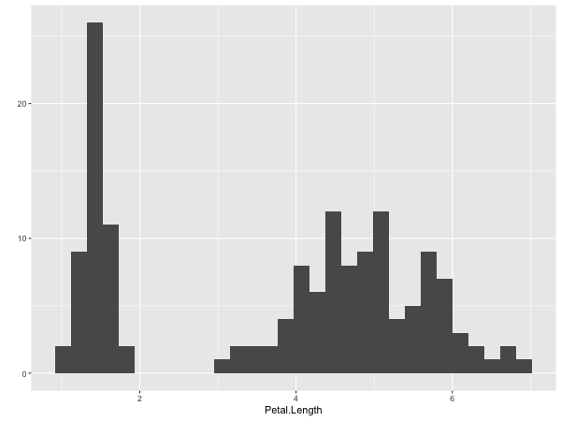
Quick plots
> qplot(Petal.Length, data = iris)

Slide 113
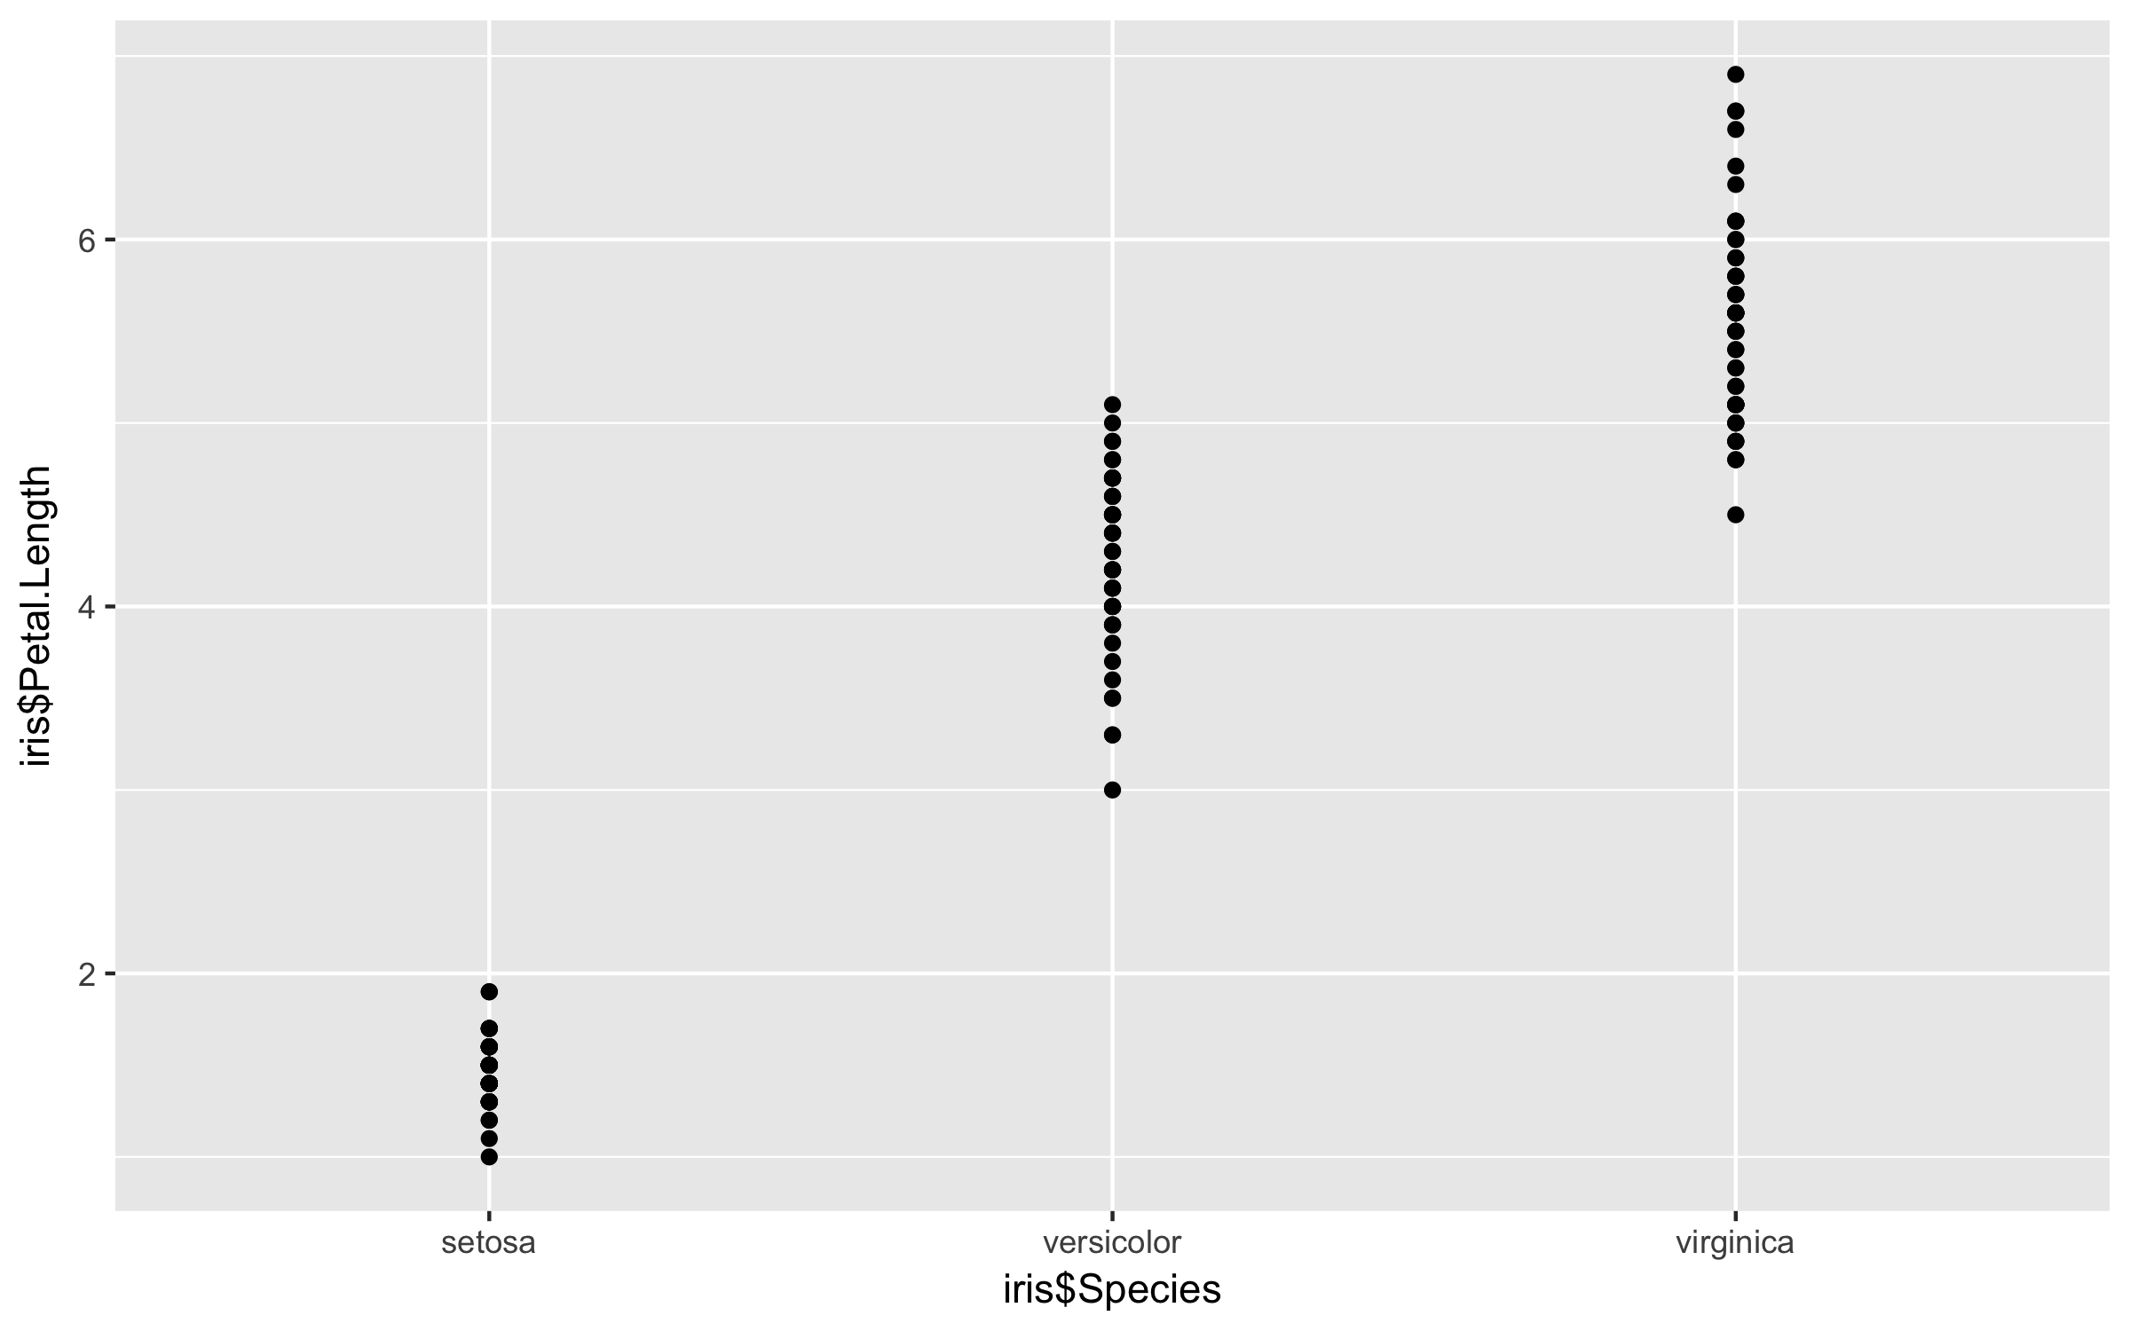
Quick plots
> qplot(Petal.Length, data = iris)
> qplot(Species, Petal.Length, data = iris)

Slide 114
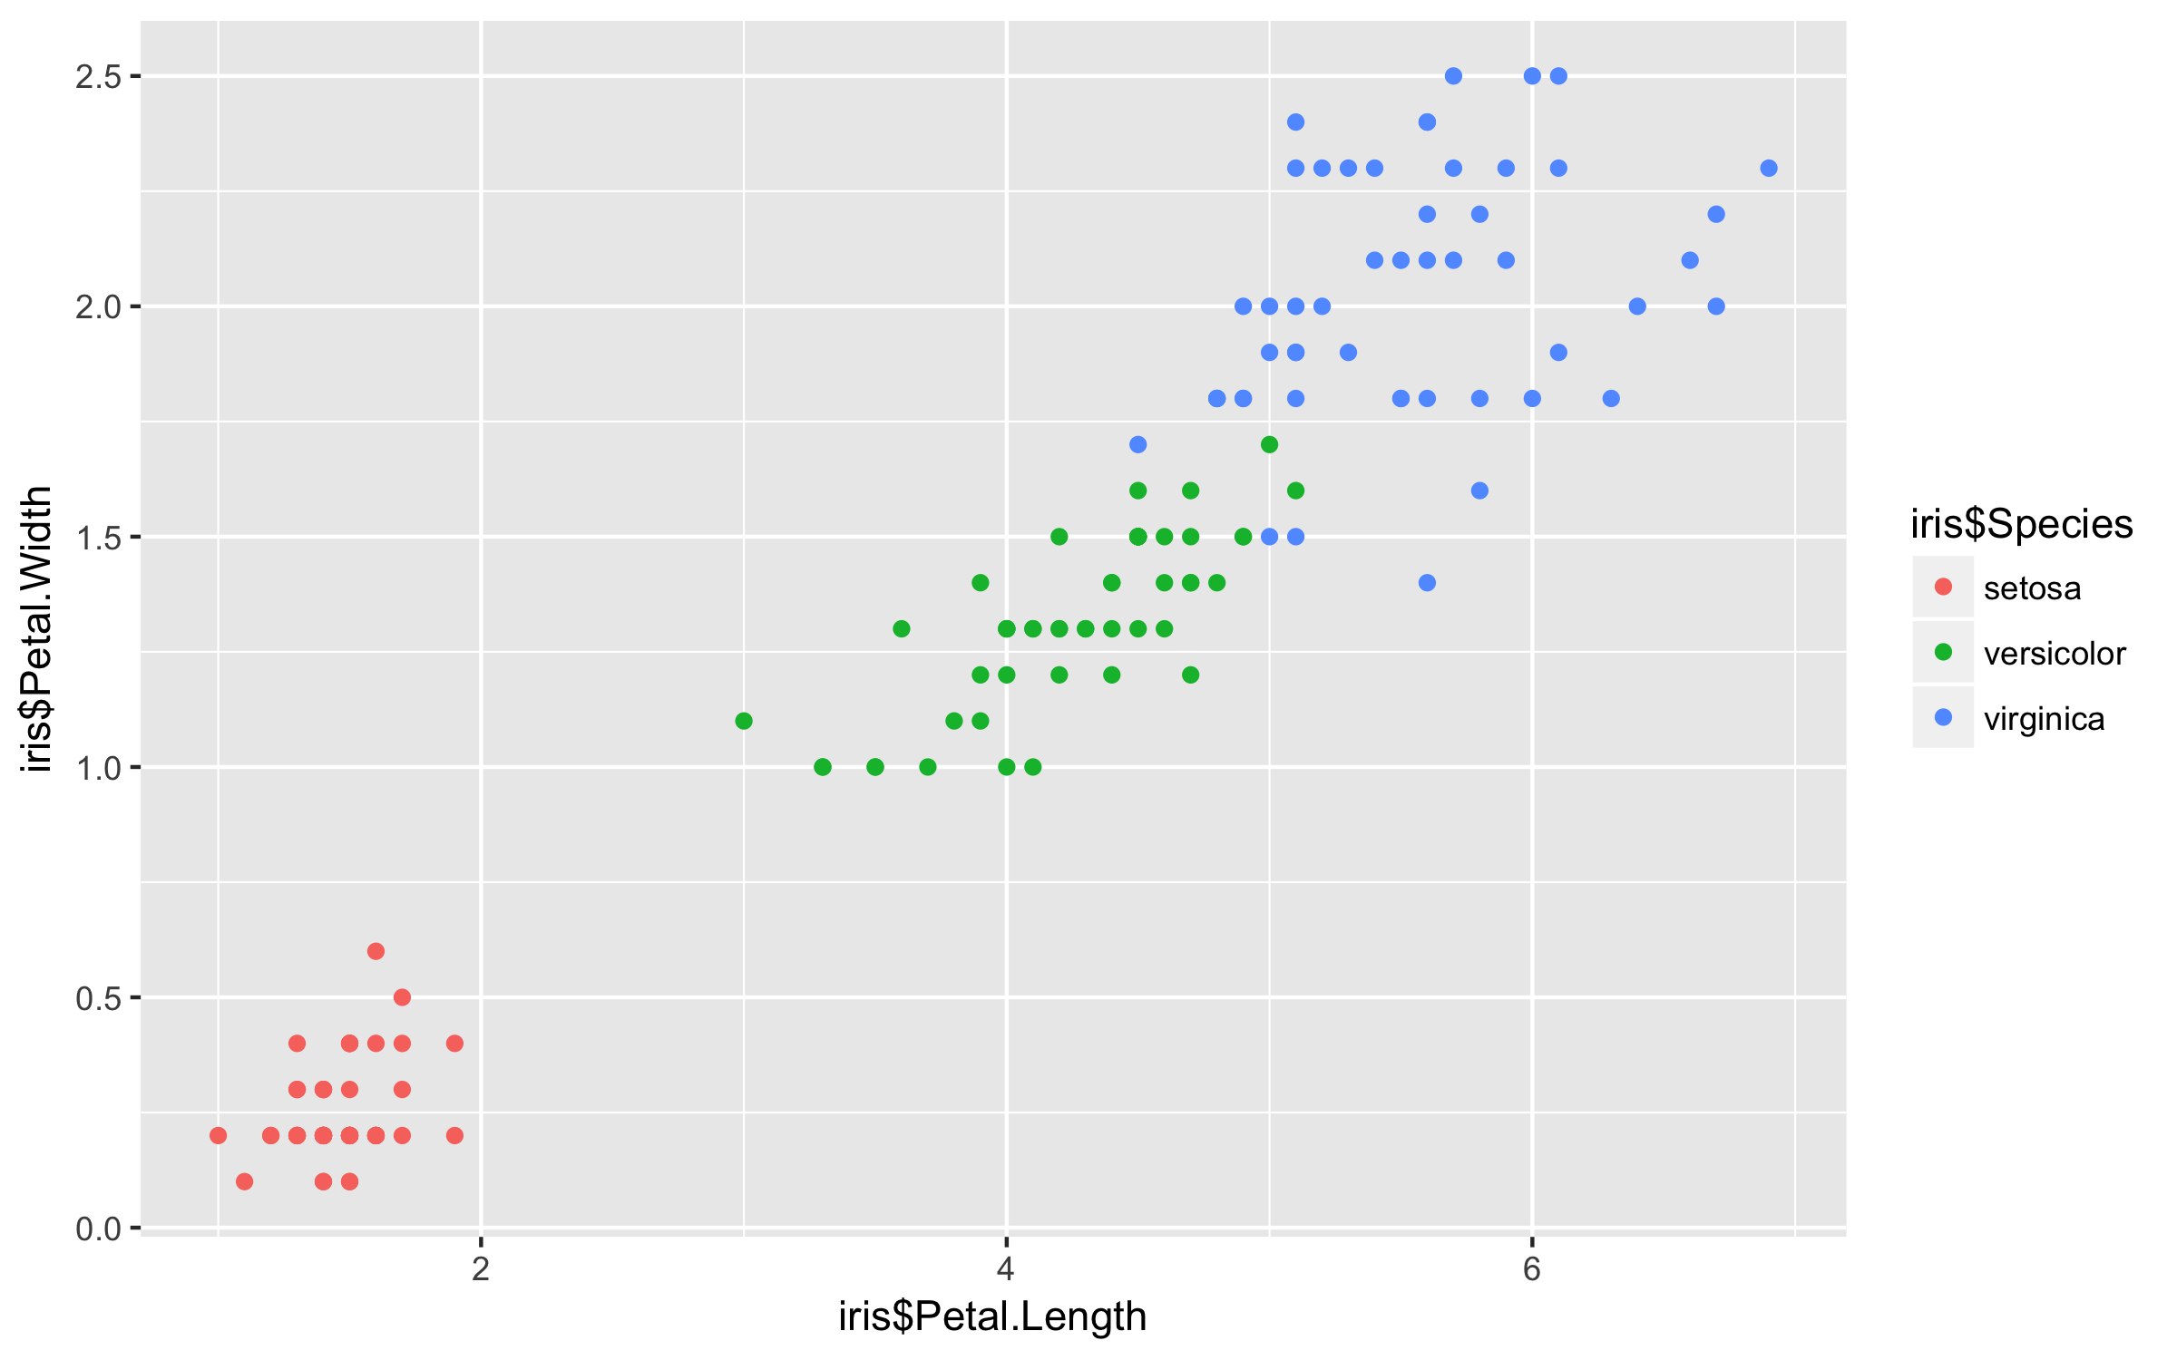
Quick plots
> qplot(Petal.Length, data = iris)
> qplot(Species, Petal.Length, data = iris)
> qplot(Petal.Length, Petal.Width, data = iris, colour=Species)

Slide 115
ggplot (grammar of graphics)

Slide 116

ggplot: Data, aesthetics, geometrics
> ggplot(iris)

Slide 117
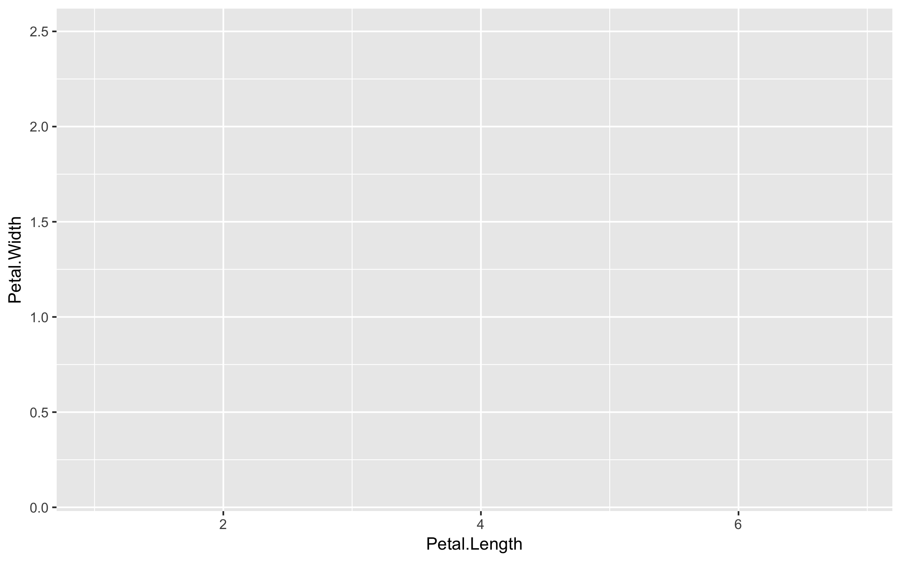
ggplot: Data, aesthetics, geometrics
> ggplot(iris)
> ggplot(iris, aes(x = Petal.Length, y = Petal.Width, colour=Species))

Slide 118
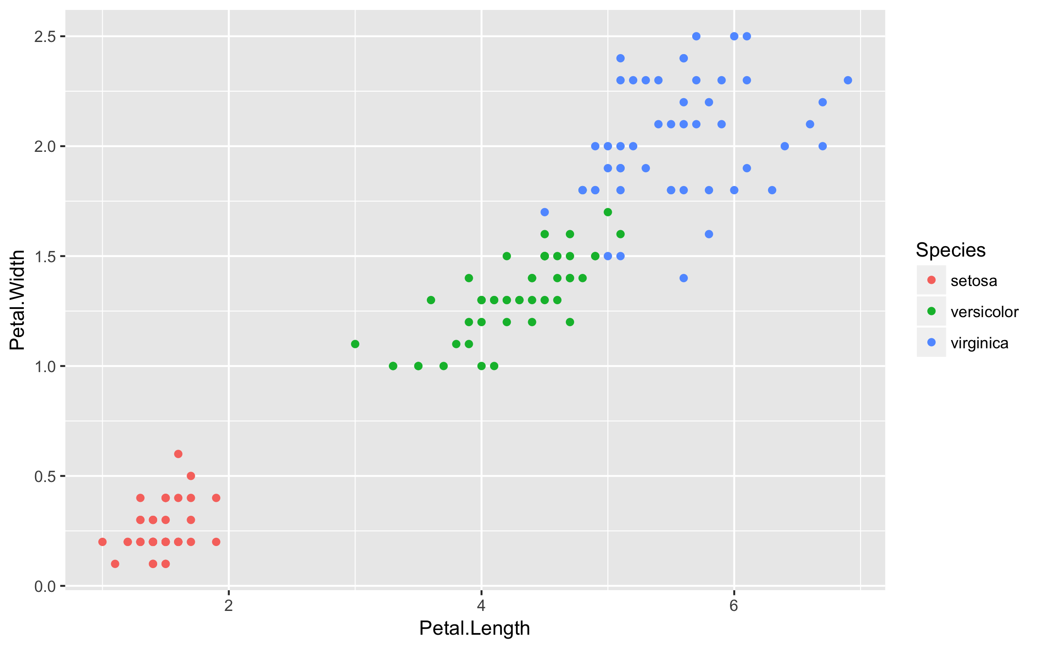
ggplot: Data, aesthetics, geometrics
> ggplot(iris)
> ggplot(iris, aes(x = Petal.Length, y = Petal.Width, colour=Species))
> ggplot(iris, aes(x = Petal.Length, y = Petal.Width, colour=Species)) +
geom_point()

Slide 119
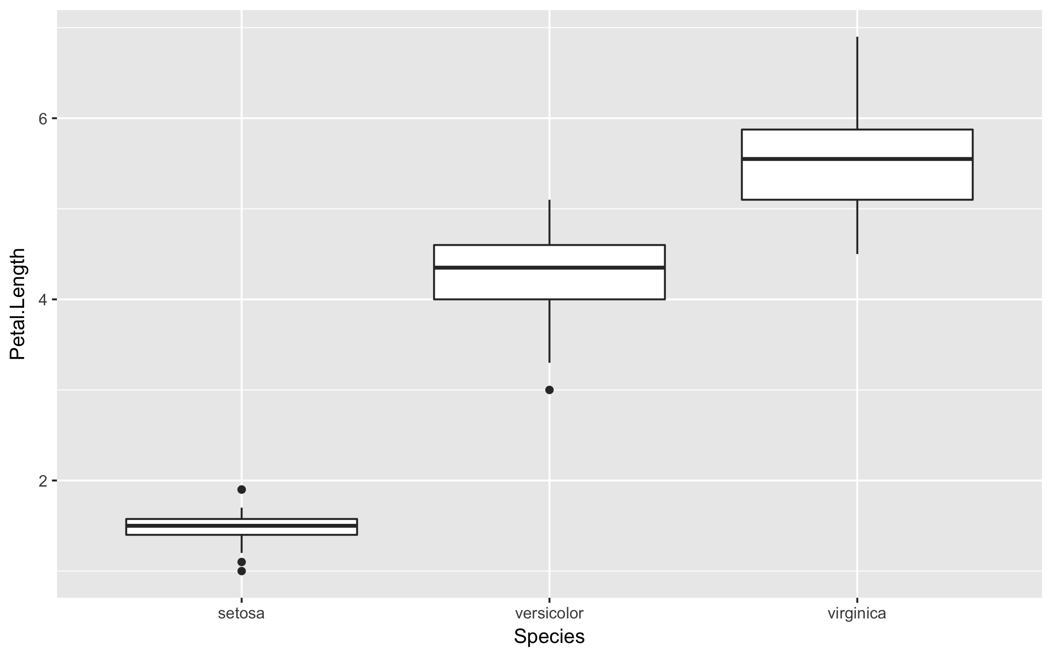
ggplot: Multiple geometric layers
> ggplot(iris, aes(x = Species, y = Petal.Length)) +
geom_boxplot()

Slide 120
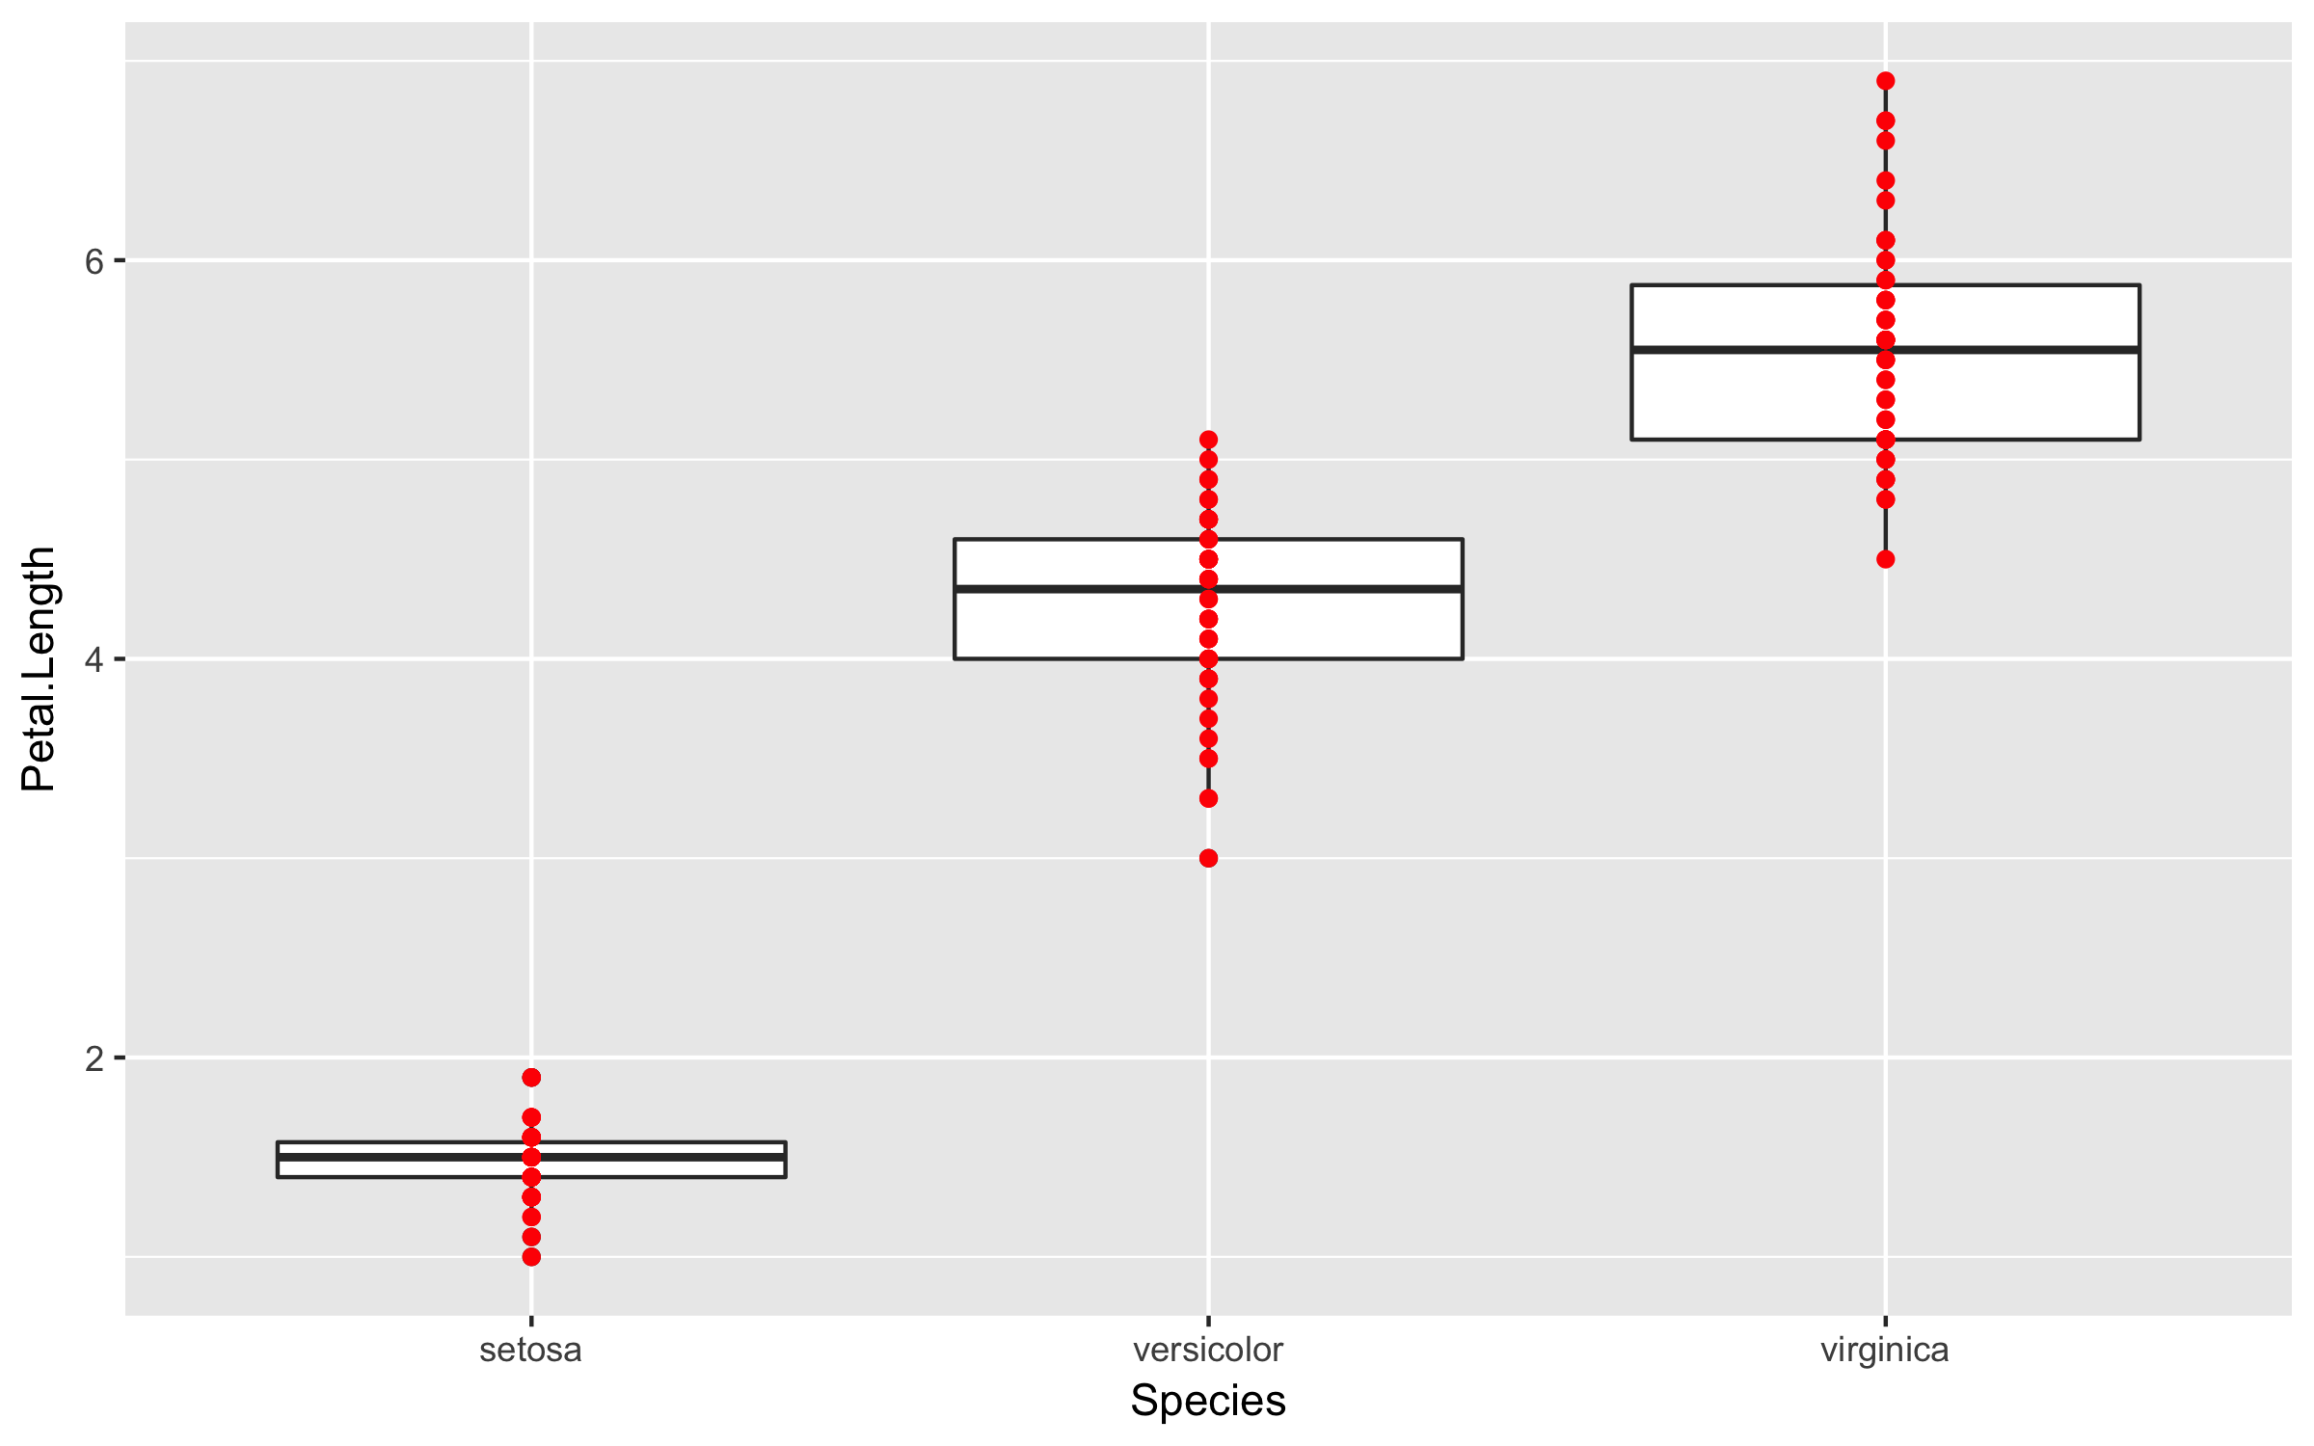
ggplot: Multiple geometric layers
> ggplot(iris, aes(x = Species, y = Petal.Length)) +
geom_boxplot() +
geom_point(colour='red')

Slide 121
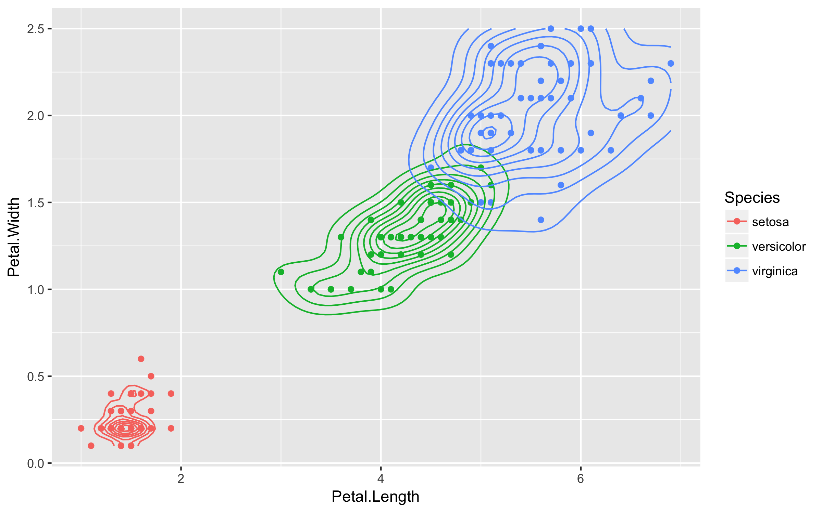
ggplot: Statistical layers
> ggplot(iris, aes(x = Petal.Length, y = Petal.Width, colour=Species)) +
geom_point() +
stat_density_2d()

Slide 122
Exercises
Please do basic exercises 2-I and 2-II.
Time left? Opt for a reading exercise or optional exercise!

Slide 123


Data transformation
Explore the power of dplyr and tidyr

Slide 124
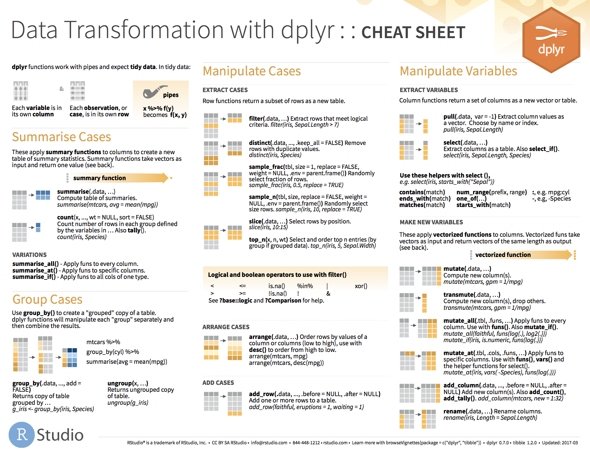

Slide 125
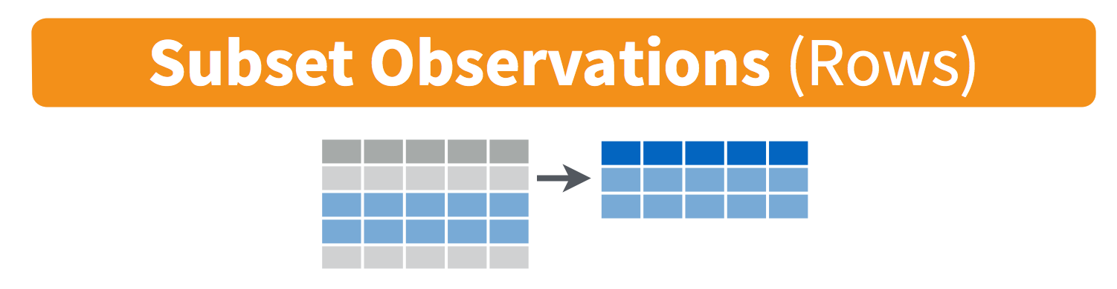
filter()
Notes:
https://jules32.github.io/2016-07-12-Oxford/dplyr_tidyr/

Slide 126
Function: filter()
> filter(iris, Species=="virginica")

Slide 127
Function: filter()
> filter(iris, Species=="virginica")
# A tibble: 50 x 5
Sepal.Length Sepal.Width Petal.Length Petal.Width Species
<dbl> <dbl> <dbl> <dbl> <fct>
1 6.30 3.30 6.00 2.50 virginica
2 5.80 2.70 5.10 1.90 virginica
3 7.10 3.00 5.90 2.10 virginica
4 6.30 2.90 5.60 1.80 virginica
5 6.50 3.00 5.80 2.20 virginica
6 7.60 3.00 6.60 2.10 virginica
7 4.90 2.50 4.50 1.70 virginica
8 7.30 2.90 6.30 1.80 virginica
9 6.70 2.50 5.80 1.80 virginica
10 7.20 3.60 6.10 2.50 virginica
# ... with 40 more rows

Slide 128
Function: filter()
> filter(iris, Species=="virginica", Sepal.Length>= 7.5)

Slide 129
Function: filter()
> filter(iris, Species=="virginica", Sepal.Length>= 7.5)
# A tibble: 6 x 5
Sepal.Length Sepal.Width Petal.Length Petal.Width Species
<dbl> <dbl> <dbl> <dbl> <fct>
1 7.60 3.00 6.60 2.10 virginica
2 7.70 3.80 6.70 2.20 virginica
3 7.70 2.60 6.90 2.30 virginica
4 7.70 2.80 6.70 2.00 virginica
5 7.90 3.80 6.40 2.00 virginica
6 7.70 3.00 6.10 2.30 virginica

Slide 130
Function: filter()
> filter(iris, Species=="virginica", Sepal.Length>= 7.5)
# A tibble: 6 x 5
Sepal.Length Sepal.Width Petal.Length Petal.Width Species
<dbl> <dbl> <dbl> <dbl> <fct>
1 7.60 3.00 6.60 2.10 virginica
2 7.70 3.80 6.70 2.20 virginica
3 7.70 2.60 6.90 2.30 virginica
4 7.70 2.80 6.70 2.00 virginica
5 7.90 3.80 6.40 2.00 virginica
6 7.70 3.00 6.10 2.30 virginica
Same as:
> filter(iris, Species=="virginica" & Sepal.Length>= 7.5)

Slide 131
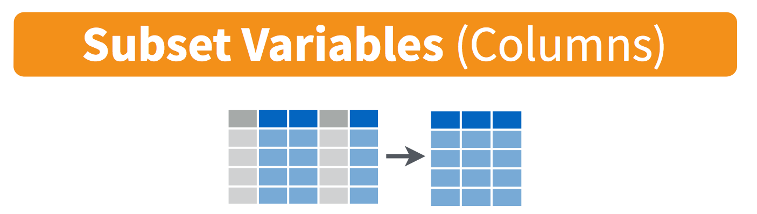
select()
Notes:
https://jules32.github.io/2016-07-12-Oxford/dplyr_tidyr/

Slide 132
Function: select()
> select(iris, Sepal.Length, Sepal.Width, Species)

Slide 133
Function: select()
> select(iris, Sepal.Length, Sepal.Width, Species)
# A tibble: 150 x 3
Sepal.Length Sepal.Width Species
<dbl> <dbl> <fct>
1 5.10 3.50 setosa
2 4.90 3.00 setosa
3 4.70 3.20 setosa
4 4.60 3.10 setosa
5 5.00 3.60 setosa
6 5.40 3.90 setosa
7 4.60 3.40 setosa
8 5.00 3.40 setosa
9 4.40 2.90 setosa
10 4.90 3.10 setosa
# ... with 140 more rows

Slide 134

Function: select()
> select(iris, Sepal.Length, Sepal.Width, Species)
> select(iris, starts_with("Sepal"), Species)

Slide 135
Function: select()
> select(iris, Sepal.Length, Sepal.Width, Species)
> select(iris, starts_with("Sepal"), Species)
# A tibble: 150 x 3
Sepal.Length Sepal.Width Species
<dbl> <dbl> <fct>
1 5.10 3.50 setosa
2 4.90 3.00 setosa
3 4.70 3.20 setosa
4 4.60 3.10 setosa
5 5.00 3.60 setosa
6 5.40 3.90 setosa
7 4.60 3.40 setosa
8 5.00 3.40 setosa
9 4.40 2.90 setosa
10 4.90 3.10 setosa
# ... with 140 more rows

Slide 136
Function: select()
> select(iris, Sepal.Length, Sepal.Width, Species)
> select(iris, starts_with("Sepal"), Species)
> select(iris, -starts_with("Petal"))

Slide 137
Function: select()
> select(iris, Sepal.Length, Sepal.Width, Species)
> select(iris, starts_with("Sepal"), Species)
> select(iris, -starts_with("Petal"))
# A tibble: 150 x 3
Sepal.Length Sepal.Width Species
<dbl> <dbl> <fct>
1 5.10 3.50 setosa
2 4.90 3.00 setosa
3 4.70 3.20 setosa
4 4.60 3.10 setosa
5 5.00 3.60 setosa
6 5.40 3.90 setosa
7 4.60 3.40 setosa
8 5.00 3.40 setosa
9 4.40 2.90 setosa
10 4.90 3.10 setosa
# ... with 140 more rows

Slide 138
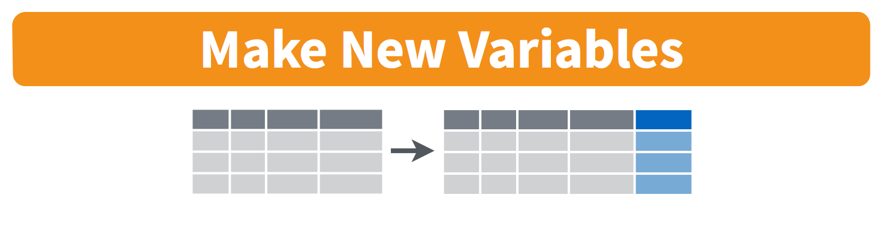
mutate()
Notes:
https://jules32.github.io/2016-07-12-Oxford/dplyr_tidyr/

Slide 139
Function: mutate()
> mutate(iris,
petal_area = pi * Petal.Length/2 * Petal.Width/2)

Slide 140
Function: mutate()
> mutate(iris,
petal_area = pi * Petal.Length/2 * Petal.Width/2)
# A tibble: 150 x 6
Sepal.Length Sepal.Width Petal.Length Petal.Width Species petal_area
<dbl> <dbl> <dbl> <dbl> <fct> <dbl>
1 5.1 3.5 1.4 0.2 setosa 0.220
2 4.9 3 1.4 0.2 setosa 0.220
3 4.7 3.2 1.3 0.2 setosa 0.204
4 4.6 3.1 1.5 0.2 setosa 0.236
5 5 3.6 1.4 0.2 setosa 0.220
6 5.4 3.9 1.7 0.4 setosa 0.534
7 4.6 3.4 1.4 0.3 setosa 0.330
8 5 3.4 1.5 0.2 setosa 0.236
9 4.4 2.9 1.4 0.2 setosa 0.220
10 4.9 3.1 1.5 0.1 setosa 0.118
# ... with 140 more rows

Slide 141
Function: mutate()
> mutate(iris,
# compute the area of a single petal
petal_area = pi * Petal.Length/2 * Petal.Width/2,
# abbreviate the name of the species
Species_abbr = substring(Species, 1, 3)
)

Slide 142
Function: mutate()
> mutate(iris,
# compute the area of a single petal
petal_area = pi * Petal.Length/2 * Petal.Width/2,
# abbreviate the name of the species
Species_abbr = substring(Species, 1, 3)
)
# A tibble: 150 x 7
Sepal.Length Sepal.Width Petal.Length Petal.Width Species petal_area Species_abbr
<dbl> <dbl> <dbl> <dbl> <fct> <dbl> <chr>
1 5.1 3.5 1.4 0.2 setosa 0.220 set
2 4.9 3 1.4 0.2 setosa 0.220 set
3 4.7 3.2 1.3 0.2 setosa 0.204 set
4 4.6 3.1 1.5 0.2 setosa 0.236 set
5 5 3.6 1.4 0.2 setosa 0.220 set
6 5.4 3.9 1.7 0.4 setosa 0.534 set
7 4.6 3.4 1.4 0.3 setosa 0.330 set
8 5 3.4 1.5 0.2 setosa 0.236 set
9 4.4 2.9 1.4 0.2 setosa 0.220 set
10 4.9 3.1 1.5 0.1 setosa 0.118 set
# ... with 140 more rows

Slide 143
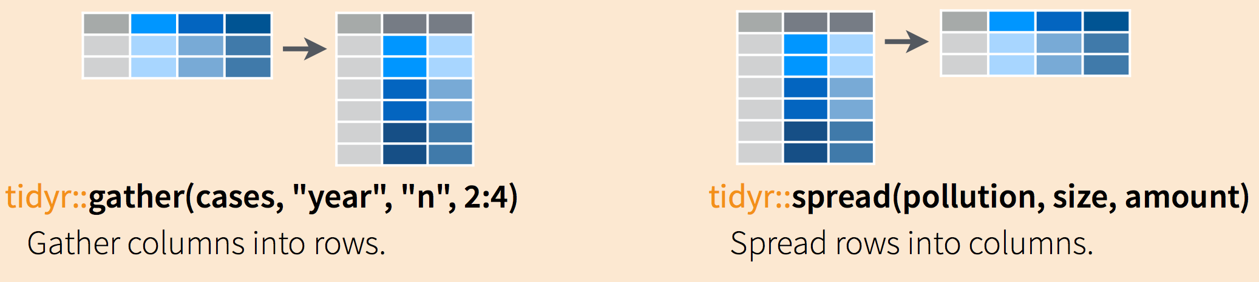
gather() and spread()
Notes:
https://jules32.github.io/2016-07-12-Oxford/dplyr_tidyr/

Slide 144
Tidy data
Each variable is a column and contains values
Each observation is a row
Each type of observational unit forms a table
Patient | Temp | Med_A | Temp_A | Med_B | Temp_B
122030 | 37.0 | 300 | 37.1 | NA | NA
122021 | 38.2 | 200 | 38.1 | 85 | 36.5
124500 | 38.1 | 300 | 38.0 | NA | NA
126098 | 39.1 | NA | NA | 100 | 36.8

Slide 145
Tidy data
# A tibble: 150 x 6
Species observation Petal.Length Petal.Width Sepal.Length Sepal.Width
<chr> <int> <dbl> <dbl> <dbl> <dbl>
1 setosa 1 1.40 0.200 5.10 3.50
2 setosa 2 1.40 0.200 4.90 3.00
3 setosa 3 1.30 0.200 4.70 3.20
4 setosa 4 1.50 0.200 4.60 3.10
5 setosa 5 1.40 0.200 5.00 3.60
6 setosa 6 1.70 0.400 5.40 3.90
7 setosa 7 1.40 0.300 4.60 3.40
8 setosa 8 1.50 0.200 5.00 3.40
9 setosa 9 1.40 0.200 4.40 2.90
10 setosa 10 1.50 0.100 4.90 3.10
# ... with 140 more rows
# A tibble: 600 x 4
Species observation measurement value
<chr> <int> <chr> <dbl>
1 setosa 1 Sepal.Length 5.10
2 setosa 1 Sepal.Width 3.50
3 setosa 1 Petal.Length 1.40
4 setosa 1 Petal.Width 0.200
5 setosa 2 Sepal.Length 4.90
6 setosa 2 Sepal.Width 3.00
7 setosa 2 Petal.Length 1.40
8 setosa 2 Petal.Width 0.200
9 setosa 3 Sepal.Length 4.70
10 setosa 3 Sepal.Width 3.20
# ... with 590 more rows
More information per row
Combines all measurements on a single individual
Necessary to plot matching measurements
More information per column
No values as column headers (tidy)
Single observation in single row (tidy)
Necessary to plot large amounts of data in a single plot

Slide 146
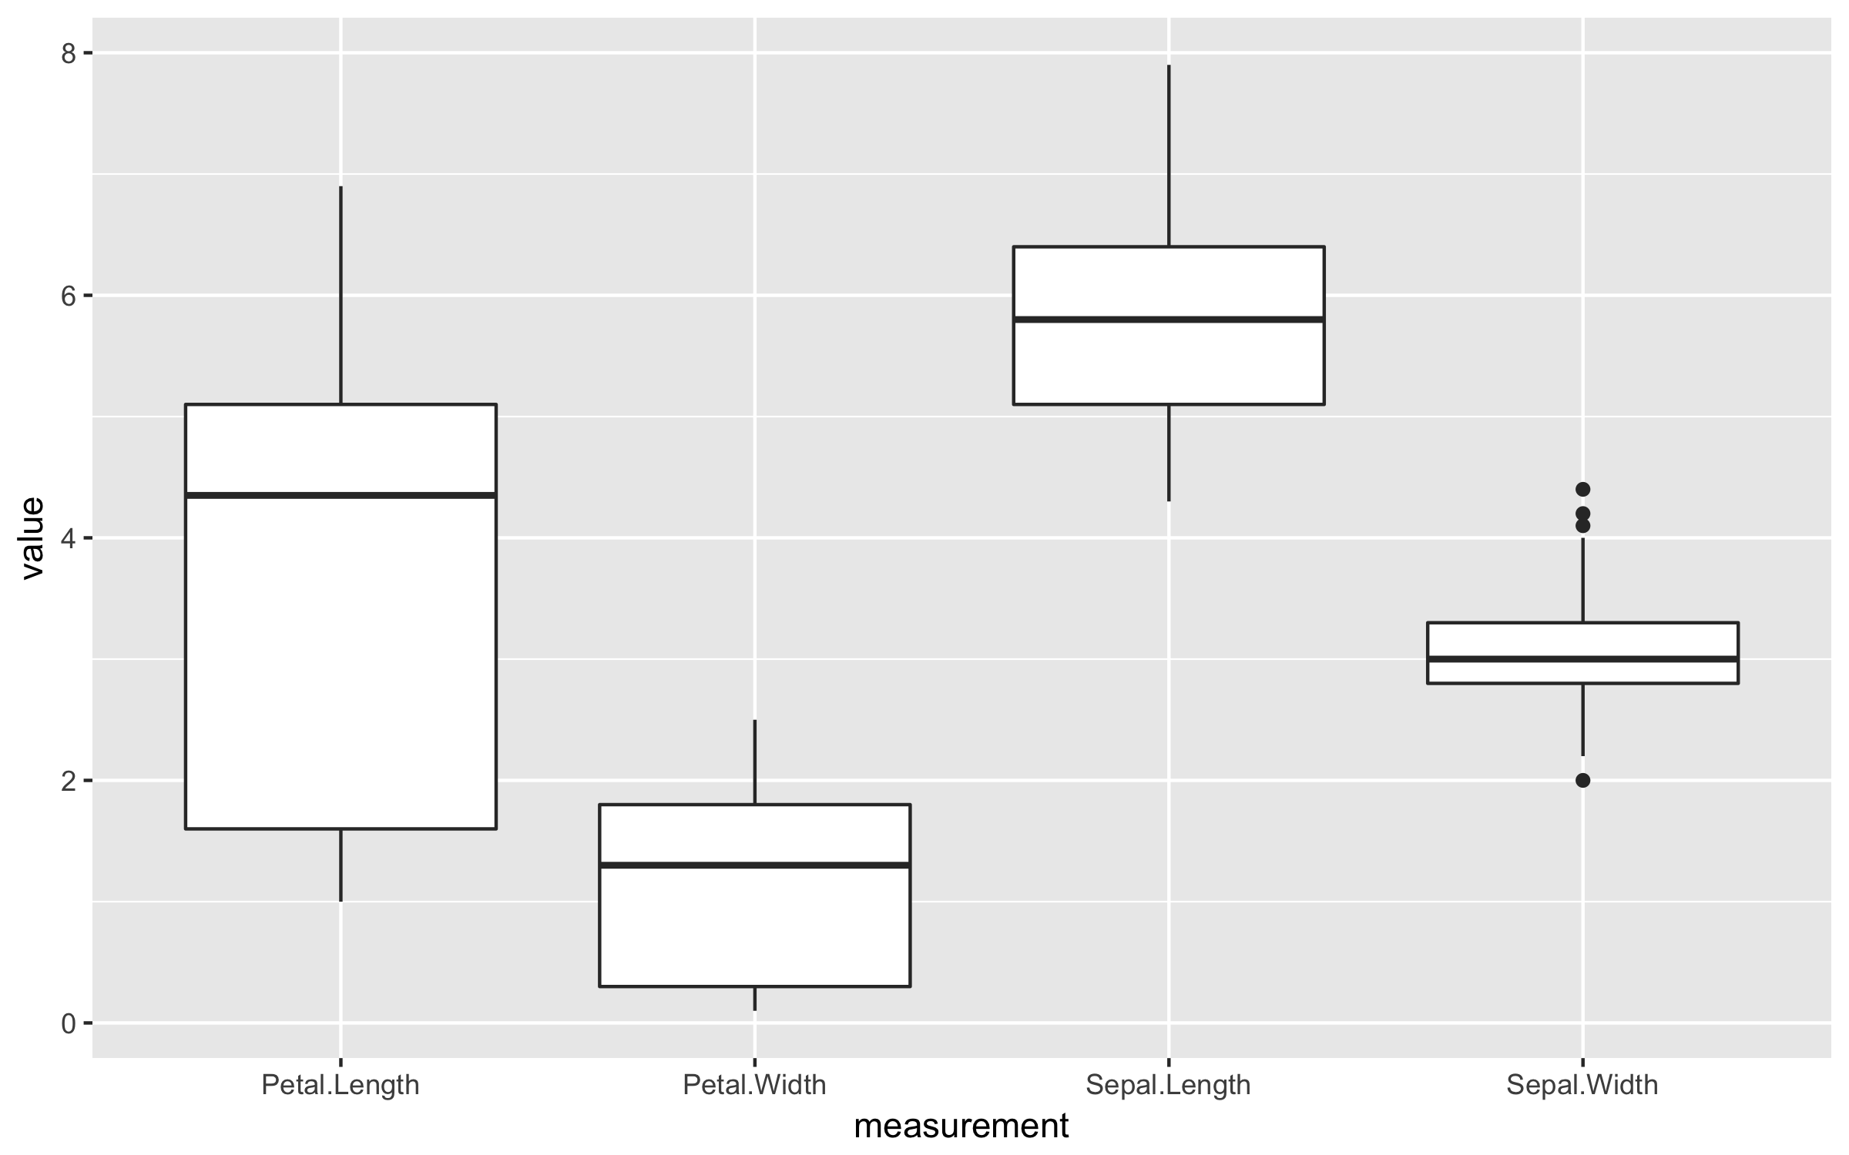
Wide vs. Long
More information per row
Combines all measurements on a single individual
Necessary to plot matching measurements
More information per column
No values as column headers (tidy)
Single observation in single row (tidy)
Necessary to plot large amounts of data in a single plot

Slide 147
Function: gather()
> iris_obs <- mutate(iris, observation = 1:n())
> iris_obs
# A tibble: 150 x 6
Sepal.Length Sepal.Width Petal.Length Petal.Width Species observation
<dbl> <dbl> <dbl> <dbl> <chr> <int>
1 5.10 3.50 1.40 0.200 setosa 1
2 4.90 3.00 1.40 0.200 setosa 2
3 4.70 3.20 1.30 0.200 setosa 3
4 4.60 3.10 1.50 0.200 setosa 4
5 5.00 3.60 1.40 0.200 setosa 5
6 5.40 3.90 1.70 0.400 setosa 6
7 4.60 3.40 1.40 0.300 setosa 7
8 5.00 3.40 1.50 0.200 setosa 8
9 4.40 2.90 1.40 0.200 setosa 9
10 4.90 3.10 1.50 0.100 setosa 10
# ... with 140 more rows
headers
content

Slide 148
Function: gather()
> iris_obs <- mutate(iris, observation = 1:n())
> iris_obs
> iris_long <- gather(iris_obs, measurement, value, Sepal.Length, Sepal.Width, Petal.Length, Petal.Width)
> iris_long
# A tibble: 600 x 4
Species observation measurement value
<chr> <int> <chr> <dbl>
1 setosa 1 Sepal.Length 5.10
2 setosa 1 Sepal.Width 3.50
3 setosa 1 Petal.Length 1.40
4 setosa 1 Petal.Width 0.200
5 setosa 2 Sepal.Length 4.90
6 setosa 2 Sepal.Width 3.00
7 setosa 2 Petal.Length 1.40
8 setosa 2 Petal.Width 0.200
9 setosa 3 Sepal.Length 4.70
10 setosa 3 Sepal.Width 3.20
# ... with 590 more rows
headers
content

Slide 149
Function: spread()
column to
headers
column to be split
as content
> iris_wide <- spread(iris_long, measurement, value)
> iris_wide
# A tibble: 150 x 6
Species observation Petal.Length Petal.Width Sepal.Length Sepal.Width
<chr> <int> <dbl> <dbl> <dbl> <dbl>
1 setosa 1 1.40 0.200 5.10 3.50
2 setosa 2 1.40 0.200 4.90 3.00
3 setosa 3 1.30 0.200 4.70 3.20
4 setosa 4 1.50 0.200 4.60 3.10
5 setosa 5 1.40 0.200 5.00 3.60
6 setosa 6 1.70 0.400 5.40 3.90
7 setosa 7 1.40 0.300 4.60 3.40
8 setosa 8 1.50 0.200 5.00 3.40
9 setosa 9 1.40 0.200 4.40 2.90
10 setosa 10 1.50 0.100 4.90 3.10
# ... with 140 more rows
necessary for grouping!

Slide 150
Exercises
Please do basic exercises 3-I and 3-II.
Time left? Opt for a reading exercise or optional exercise!

Slide 151
All done? Time to knit!

Slide 152
Introduction to R & data
Before you leave…

Slide 153
Other RDM workshops
https://www.uu.nl/en/research/research-data-management/tools-services/training-and-workshops
Learn to write your Data Management Plan (online course)
Quickstart to Research Data Management

Slide 154
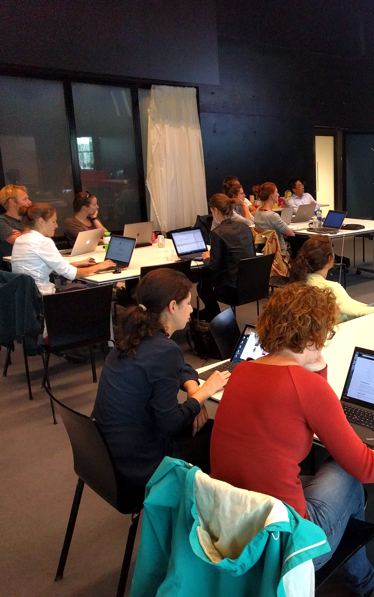
R Cafe
Monthly event for R programmers
Join the R community
Work on your project with the ability to ask questions
Subscribe to the newsletter or follow RDM support website
Check https://github.com/UtrechtUniversity/R-data-cafe
Next edition: Monday 25/3, 15:00-17:00

Slide 155
Feedback is cool.
Please send your feedback, remarks, questions to Barbara: b.m.i.vreede@uu.nl
Or generate an issue on github!
tinyurl.com/introRData

Slide 156
useR <- function(){
print("Good luck and see you!")
}
useR()

